Slide 1



Unconvex nesting optimization
A genetic algorithm based nesting procedure to achive high-performance results
Notes:
asd

Slide 2
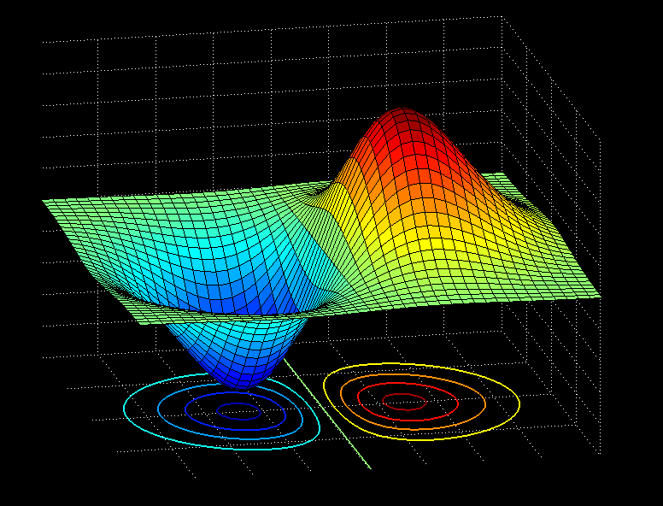
Contents
What is an optimization problem
Convex vs unconvex problems
The nesting problem
Machine learning & nesting problem
Notes:
<xcc

Slide 3

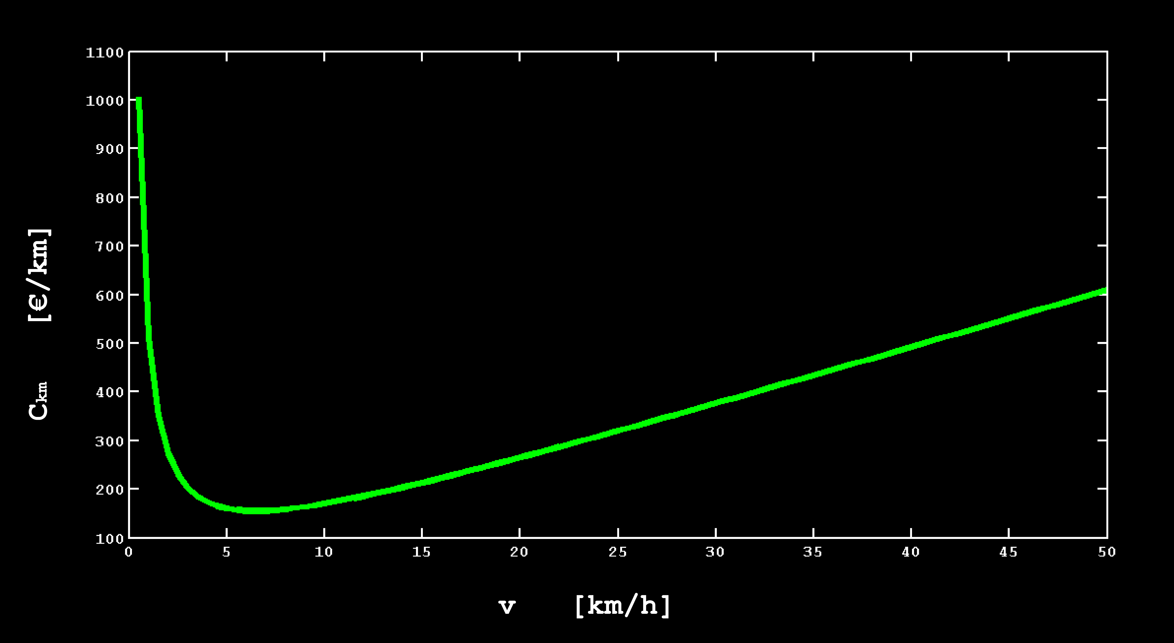


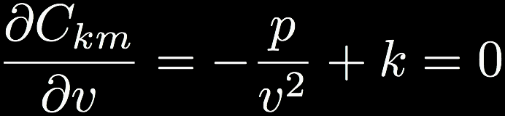
Optimization problems
Given a function f(x) find the value of x that minimizes f(x)
Example:
When a ship is sailing, the fuel cost is proportional to the square of its speed. Besides that, there are fixed costs, which do not depend on the speed and are equal to p (€/hour).
At what speed the total cost per 1 km will be the lowest?
k → proportionality constant [ € h km⁻² ]
p → fixed cost [ € h⁻¹ ]
Total cost per hour:
Optimal speed:
Total cost per km:

Slide 4
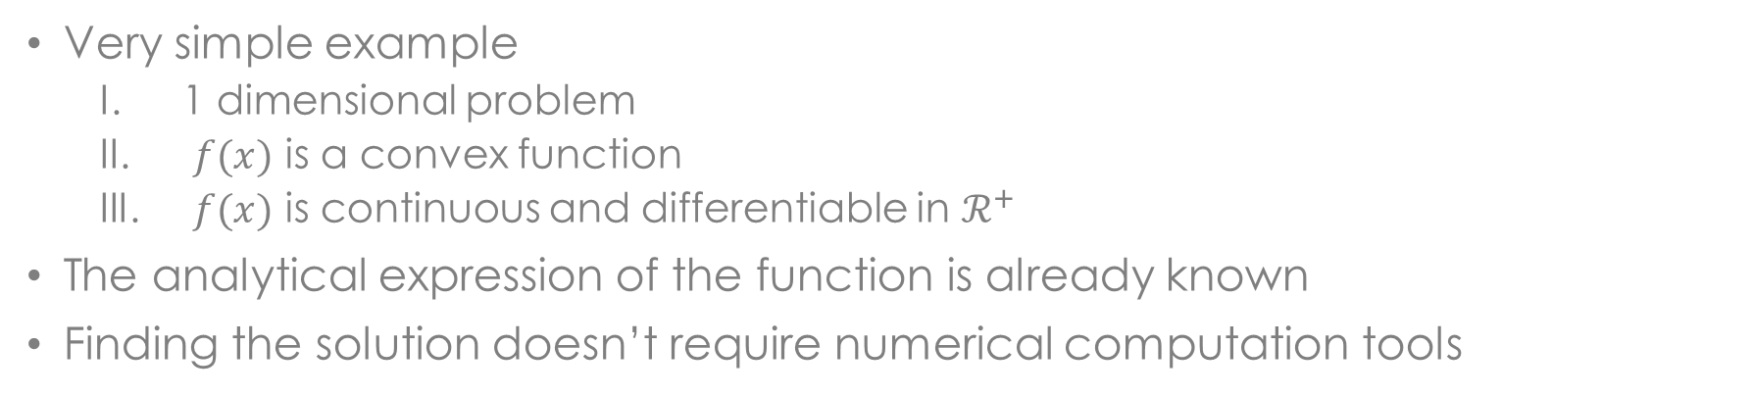
Example - summary
Very simple example
1 dimensional problem
$f(x)$ is a convex function
$f(x)$ is continuous and differentiable in $ℛ^{+}$
The analytical expression of the function is already known
Finding the solution doesn’t require numerical computation tools

Slide 5
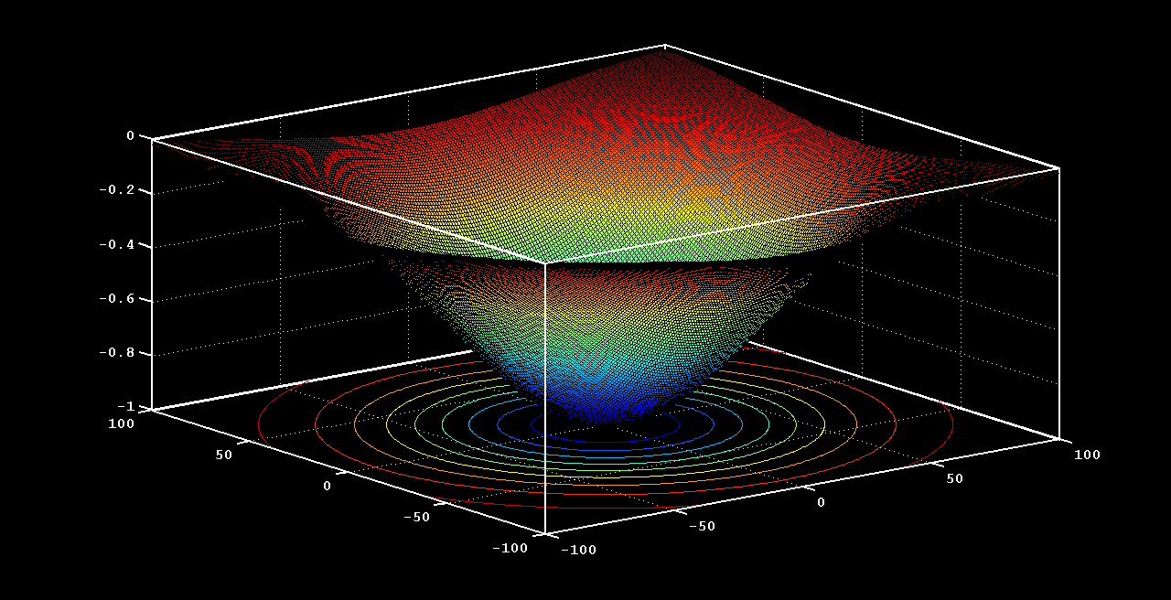
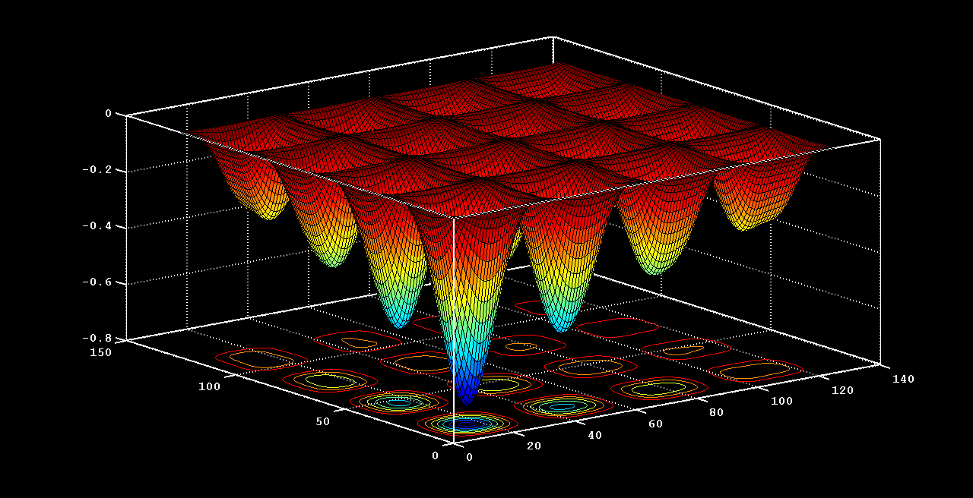
Two kind of problems
Convex Optimization
Exists only one minimum
It is always possible to reach the global minimum
Unconvex Optimization
Potentially many local minima
Saddle points and very flat regions
Convex methods like Gradient Descent brings you to the nearest minimum
NP-hard problem

Slide 6
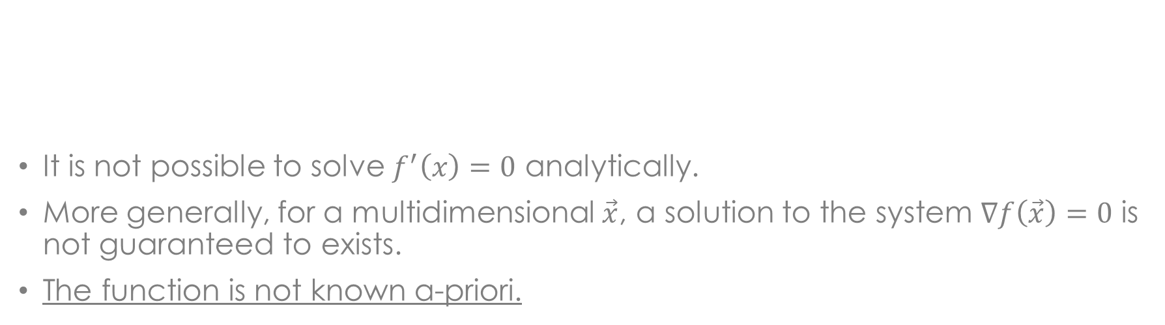
NUMERICAL MINIMIZATION
PROBLEM: it is not always possible to find an analytical solution
Why?
It is not possible to solve $f^{′}\left(x\right)=0$ analytically.
More generally, for a multidimensional $\vec{x}$, a solution to the system $∇f\left(\vec{x}\right)=0$ is not guaranteed to exists.
The function is not known a-priori.
Solution: NUMERICAL MINIMIZATION

Slide 7

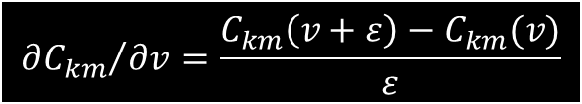

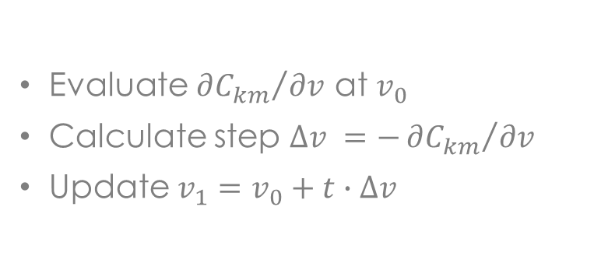
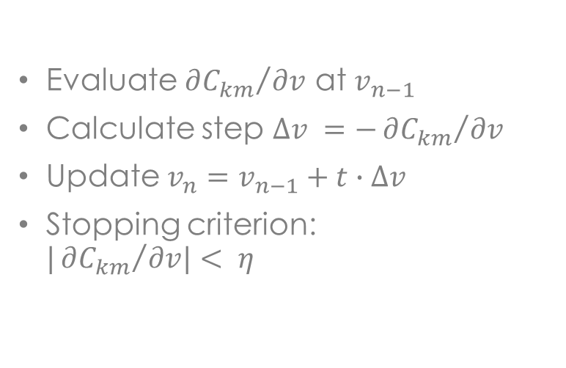

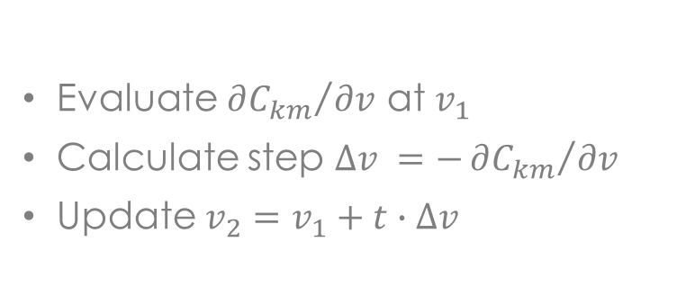


Numerical minimization
Gradient Descent Method
Assumptions:
Expressions of both function and its derivative not known a priori
Initial evaluation of $C_{km}$ at $v_{0}$
$$v_{0}$$
Pseudo-code:
$$v_{1}$$
$$v_{2}$$
Evaluate ${∂C_{km}}/{∂v}$ at $v_{0}$
Calculate step $∆v =−{∂C_{km}}/{∂v}$
Update $v_{1}=v_{0}+t∙∆v$
Evaluate ${∂C_{km}}/{∂v}$ at $v_{1}$
Calculate step $∆v =−{∂C_{km}}/{∂v}$
Update $v_{2}=v_{1}+t∙∆v$
Evaluate ${∂C_{km}}/{∂v}$ at $v_{n−1}$
Calculate step $∆v =−{∂C_{km}}/{∂v}$
Update $v_{n}=v_{n−1}+t∙∆v$
Stopping criterion: $|{∂C_{km}}/{∂v|< η}$
$$v_{n}$$
$${∂C_{km}}/{∂v}=\frac{C_{km}\left(v+ε\right)−C_{km}(v)}{ε}$$
* The optimal value for $t$ can be determined via backtracking line search

Slide 8




Convex problem
$$\vec{x_{0}}$$
$$\vec{x_{1}}$$
$$\vec{x_{2}}$$
$$\vec{x_{n}}$$

Slide 9
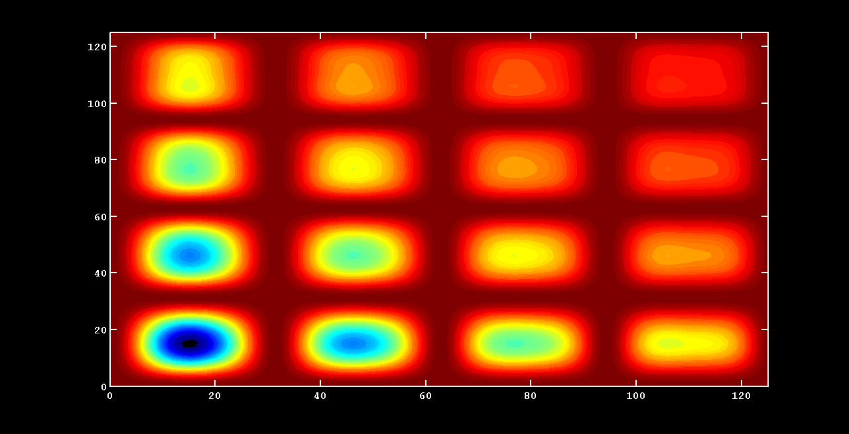
Unconvex problems
Why Gradient Descent methods fails with unconvex problems?
Global minimum

Slide 10

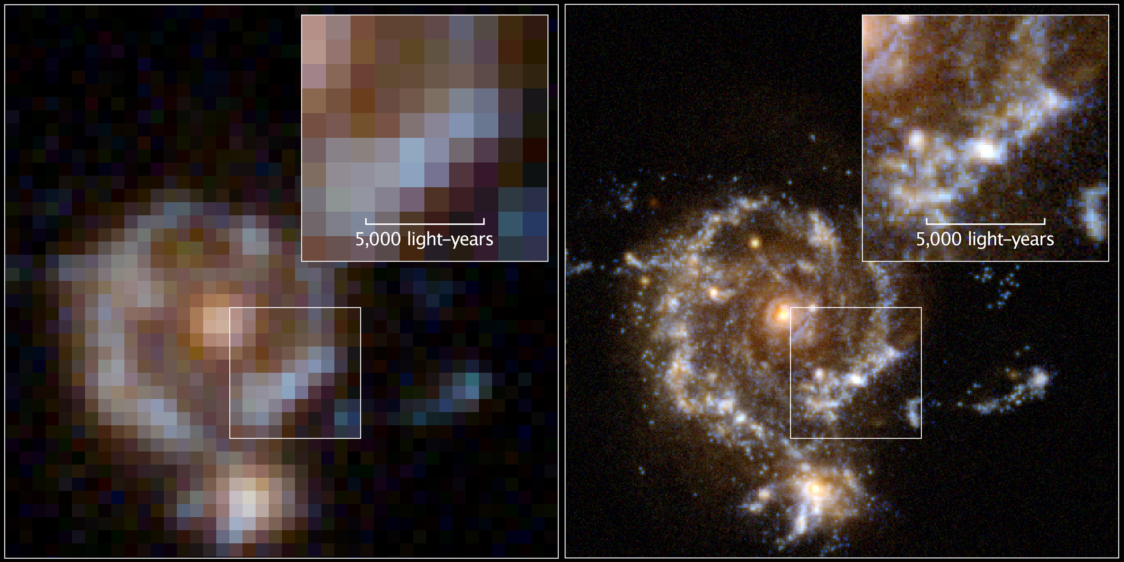
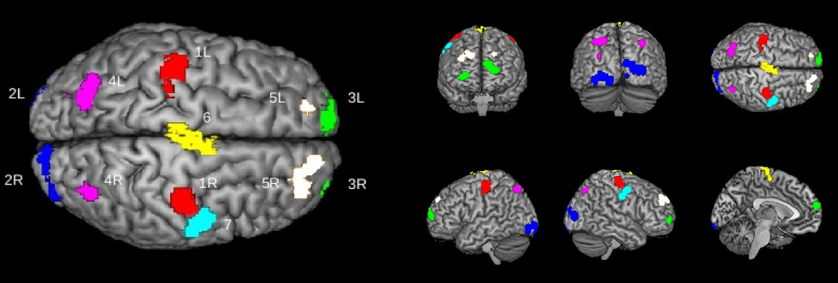
unconvex problems
Some examples:
Clustering
Deep neural networks
Computer vision → image recognition and classification
Autoencoders → speech recognition
…
The salesman problem
Matrix completion → the Netflix problem (1,000,000 USD)
Aberration correction in astronomy and microscopy
The nesting problem
* "fMRI single trial discovery of spatio‐temporal brain activity patterns" – Allegra M. et al.

Slide 11
Solve unconvex problems
Exploits method derived from convex optimization
Stochastic gradient descent
Mini-batch
…
Use several starting points combined with convex optimization methods
But:
Convergence is not assured
It is possible to converge to a bad local minima
Possible solution: GENETIC ALGORITHM

Slide 12

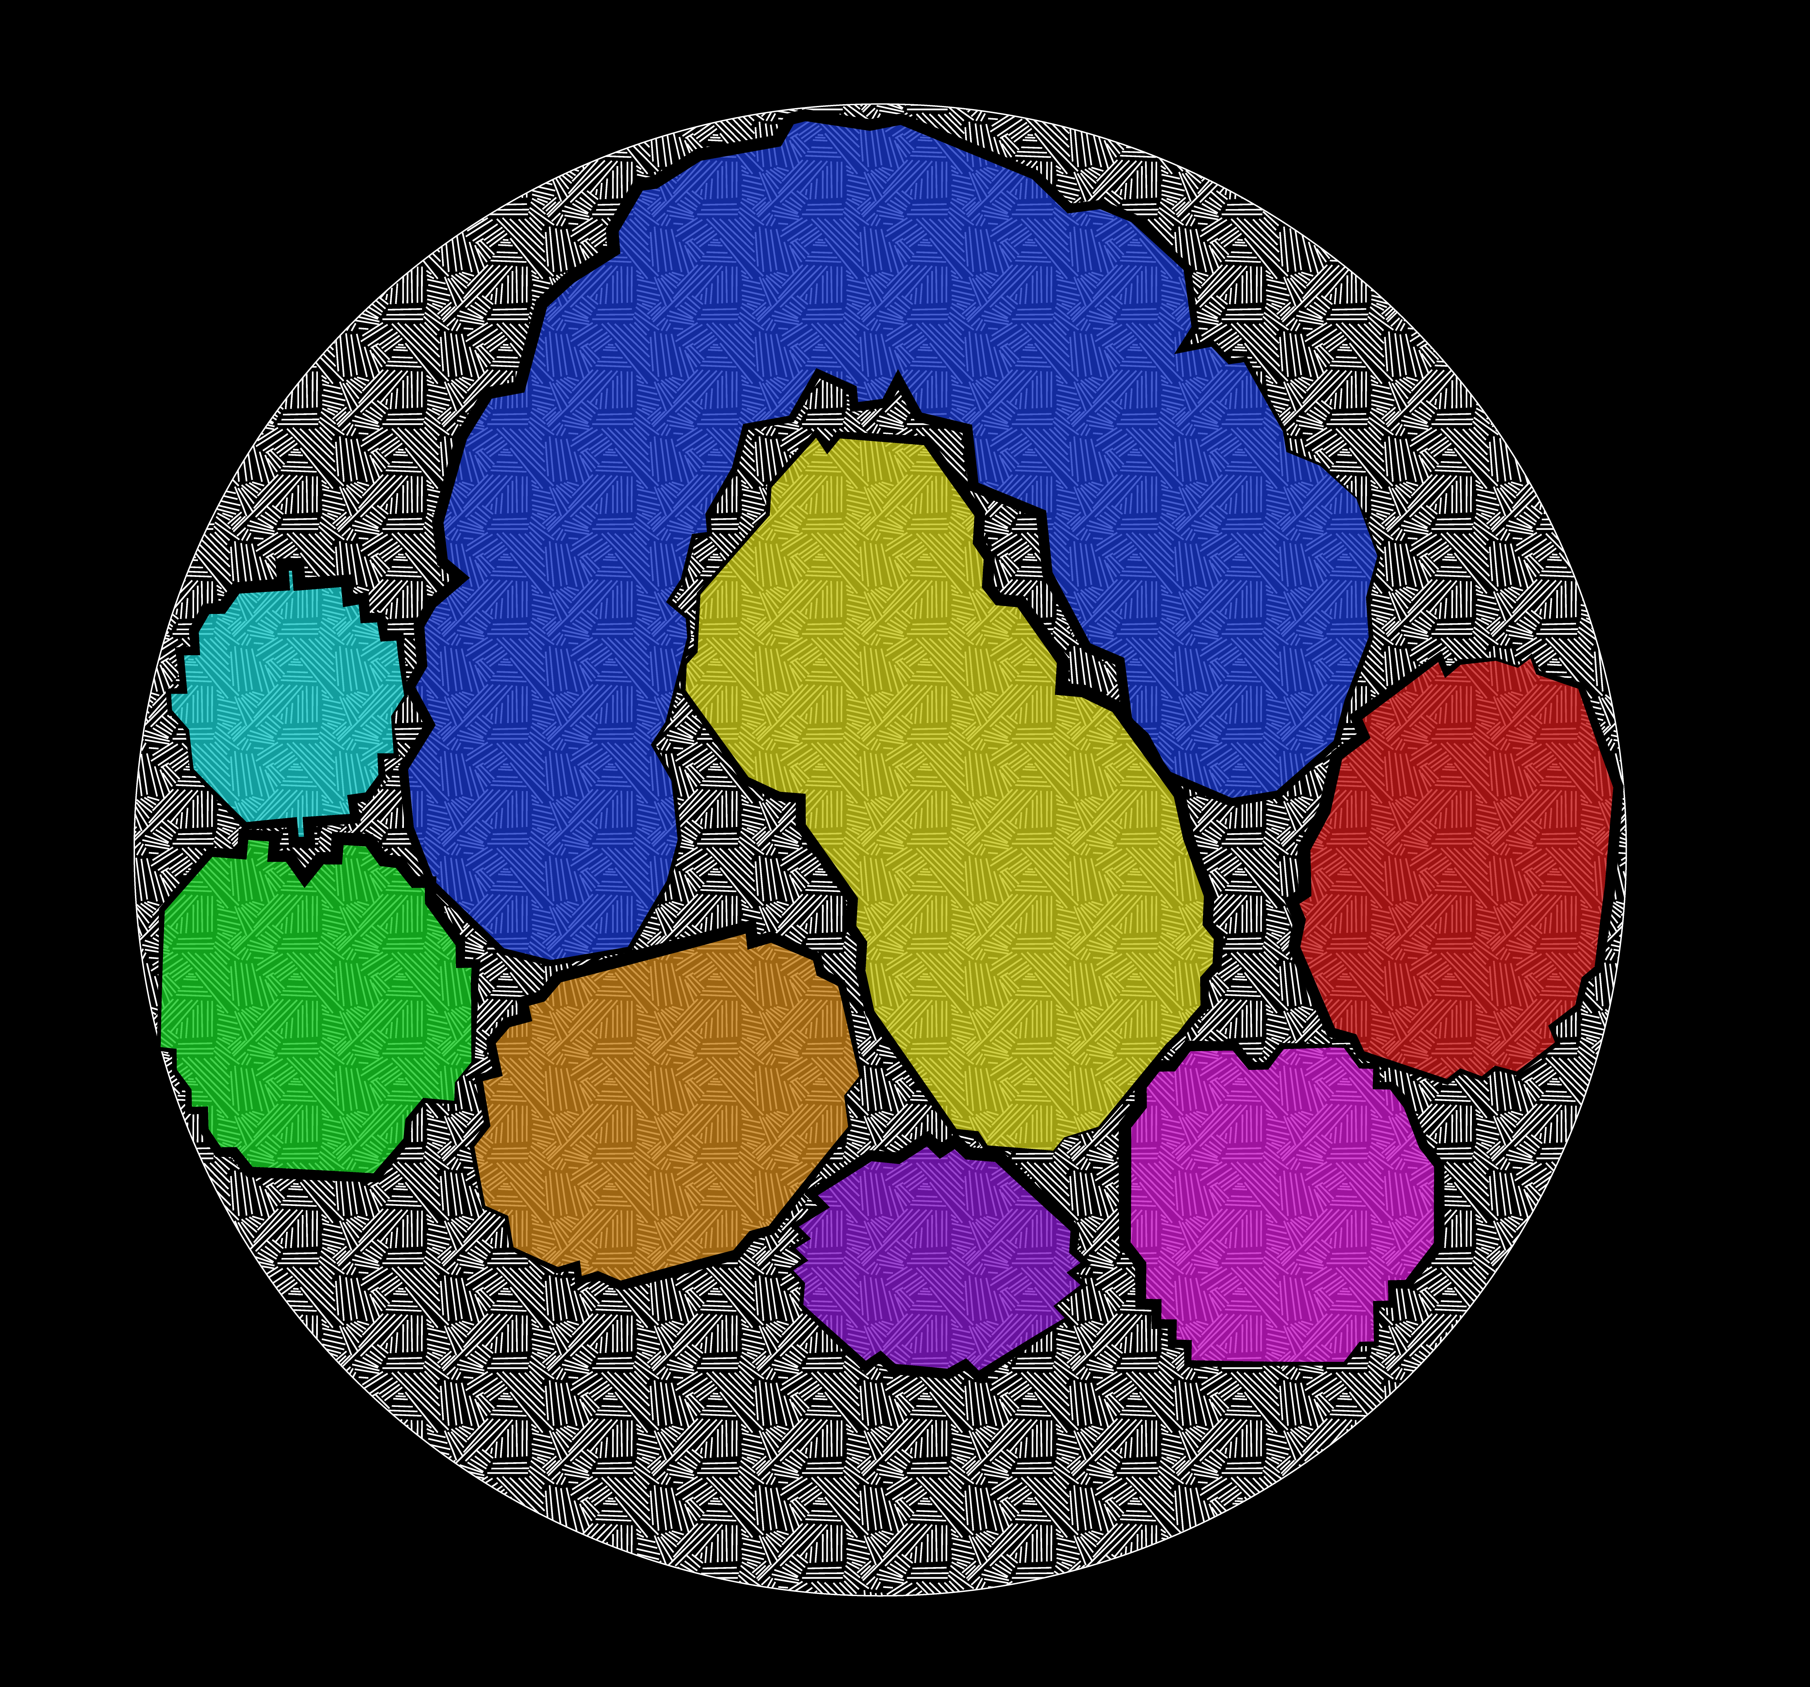
summary
Genetic algorithm
The Nesting problem

Slide 13
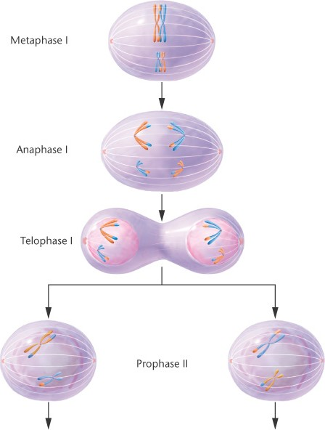
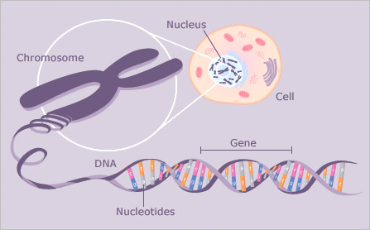
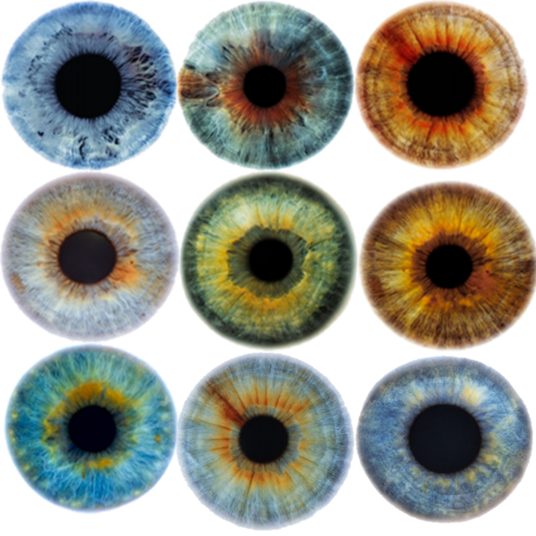
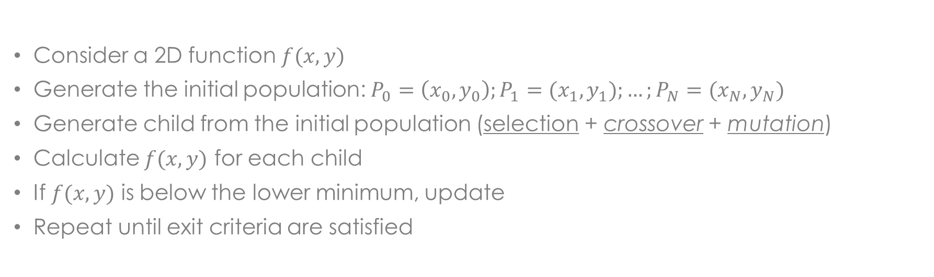
Genetic algorithm
Goal: find the global minimum of a function by mimicking biology
PRACTICAL EXAMPLE
Consider a 2D function $f(x,y)$
Generate the initial population: $P_{0}=\left(x_{0},y_{0}\right);P_{1}=(x_{1},y_{1});…;P_{N}=(x_{N},y_{N})$
Generate child from the initial population (selection + crossover + mutation)
Calculate $f(x,y)$ for each child
If $f(x,y)$ is below the lower minimum, update
Repeat until exit criteria are satisfied
* Credit: Massachusetts General Hospital

Slide 14

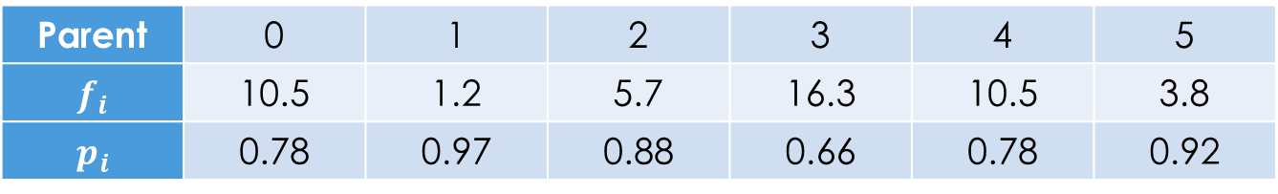

Genetic algorithm
Selection: choose the best parents to generate the child
Parent | 0 | 1 | 2 | 3 | 4 | 5
$$f_{i}$$ | 10.5 | 1.2 | 5.7 | 16.3 | 10.5 | 3.8
$$p_{i}$$ | 0.78 | 0.97 | 0.88 | 0.66 | 0.78 | 0.92
$$p_{i}=1−\frac{f_{i}}{\sum_{i}{f_{i}}}$$
Random number
0
0.78
0.78 + 0.97
…
$$\sum_{i}{p_{i}}$$

Slide 15
Genetic algorithm
Crossover: exchange the genome of the parents to generate two child
 | x | y | f(x,y)
Parent 1 | 5 | 12 | 7.9
Parent 2 | 8 | 3 | 4.3
Child 1 | 5 | 3 | 2.1
Child 2 | 8 | 12 | 8.8
Random choose the crossover point:
C1
P1 | a | b | c | d | e | f | g
P2 | h | i | l | m | n | o | p
C2

Slide 16
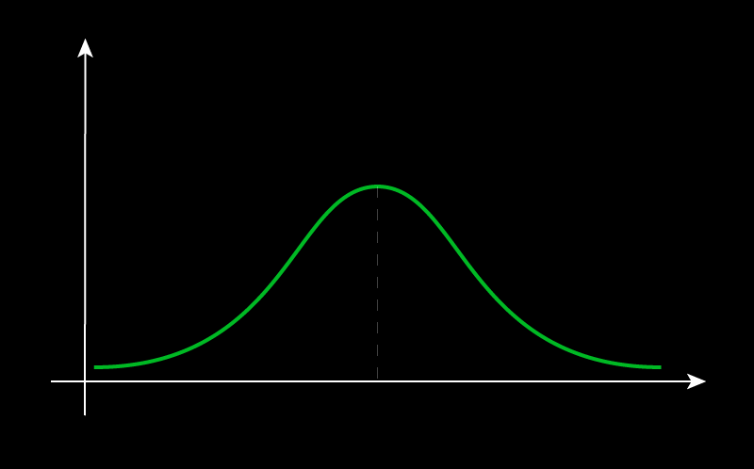




Genetic algorithm
Mutation: alter the value of a gene due to some random distribution
$$P$$
 | a | b | c | d | e | f | g
C | 5 | 3 | 12 | 4 | 0 | 5 | 17
The choice of the distribution is very important
 | a | b | c | d | e | f | g
C | 5 | 3 | 12 | 8 | 0 | 5 | 17
$$4$$
$$8$$
$$d$$

Slide 17

Genetic algorithm
Exit criteria:
Last generation reached
No more improvements in the minimum value of $f(x,y)$
Maximum elaboration time reached
Advanced strategies:
Change selection method
Multi-Point Crossover
Multi-Point Mutation
Search refinement

Slide 18
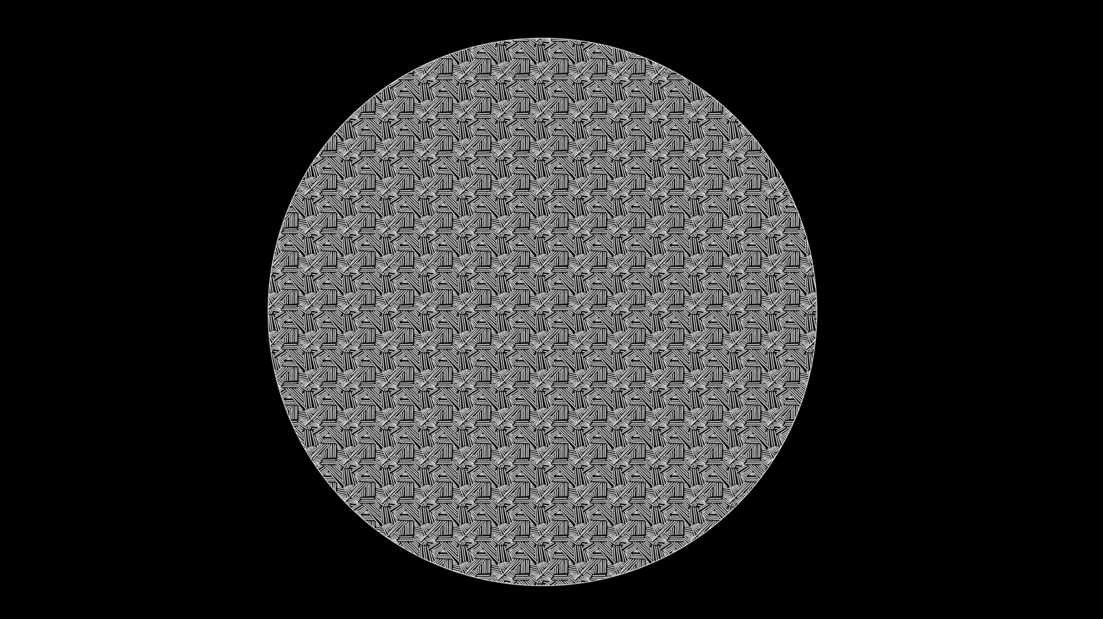
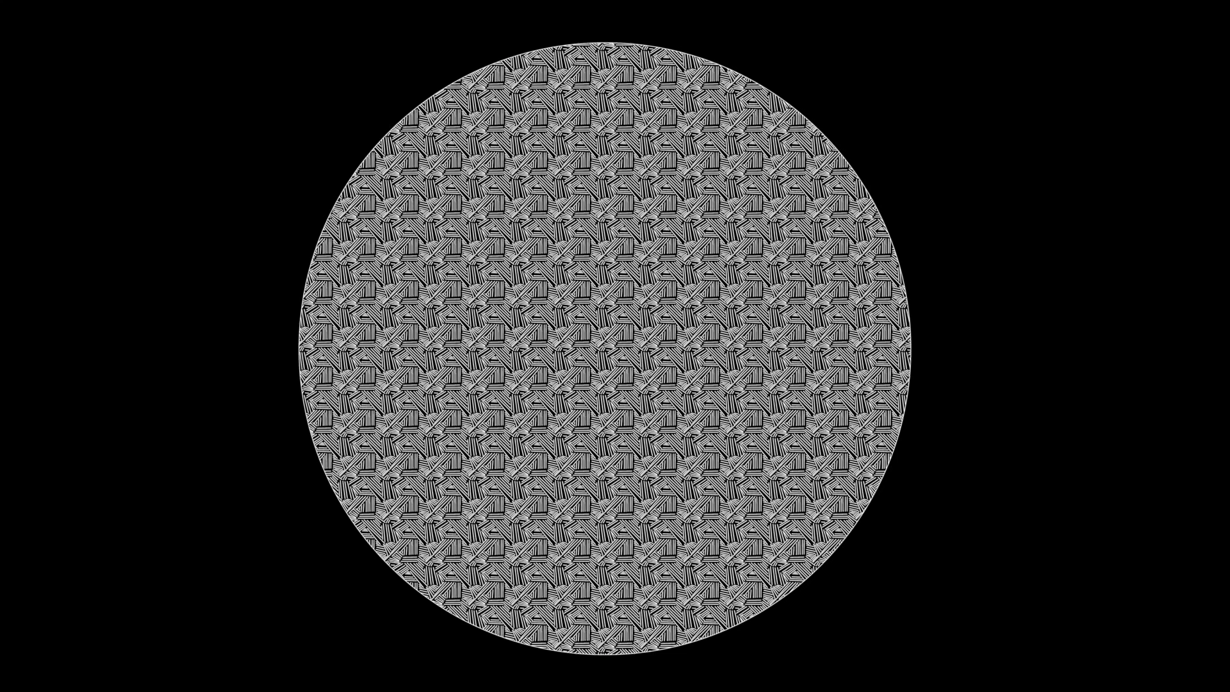
The nesting problem
Non-overlapping placement of a set of irregular 2D shapes within some region of 2D space (i.e. a rectangle or a circle) in the most compact way.
Bad Nesting
Good Nesting

Slide 19
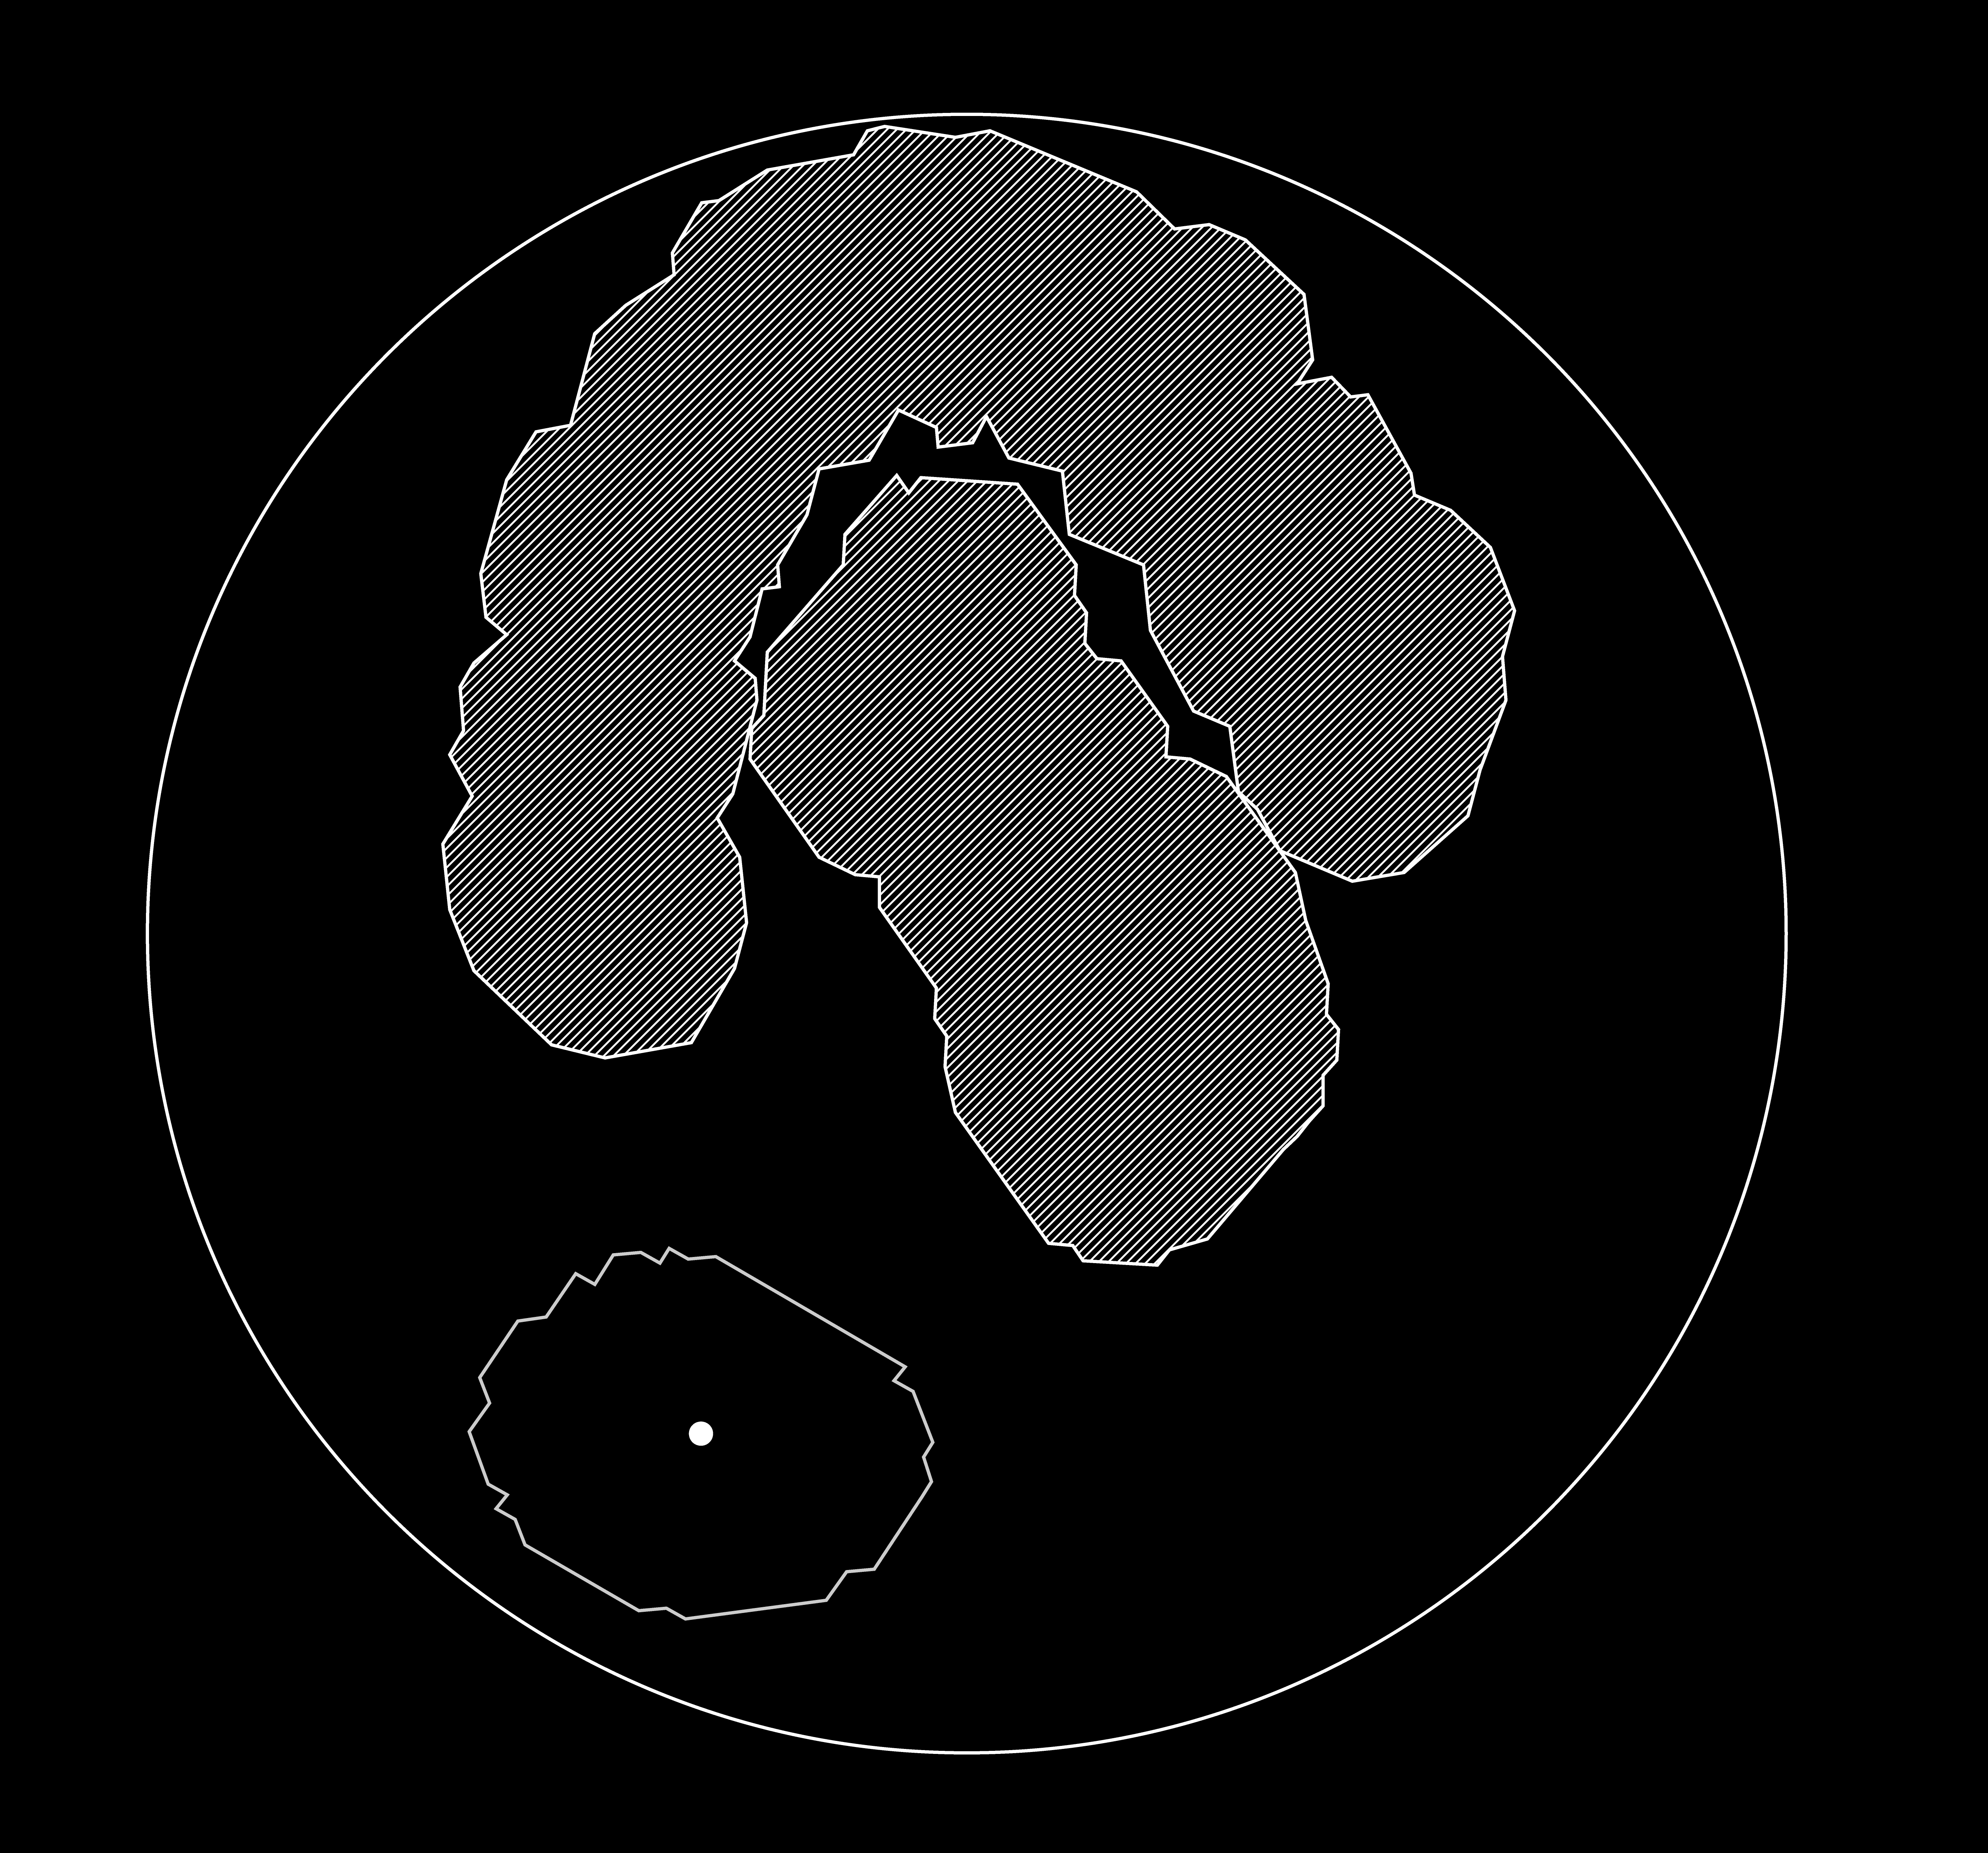
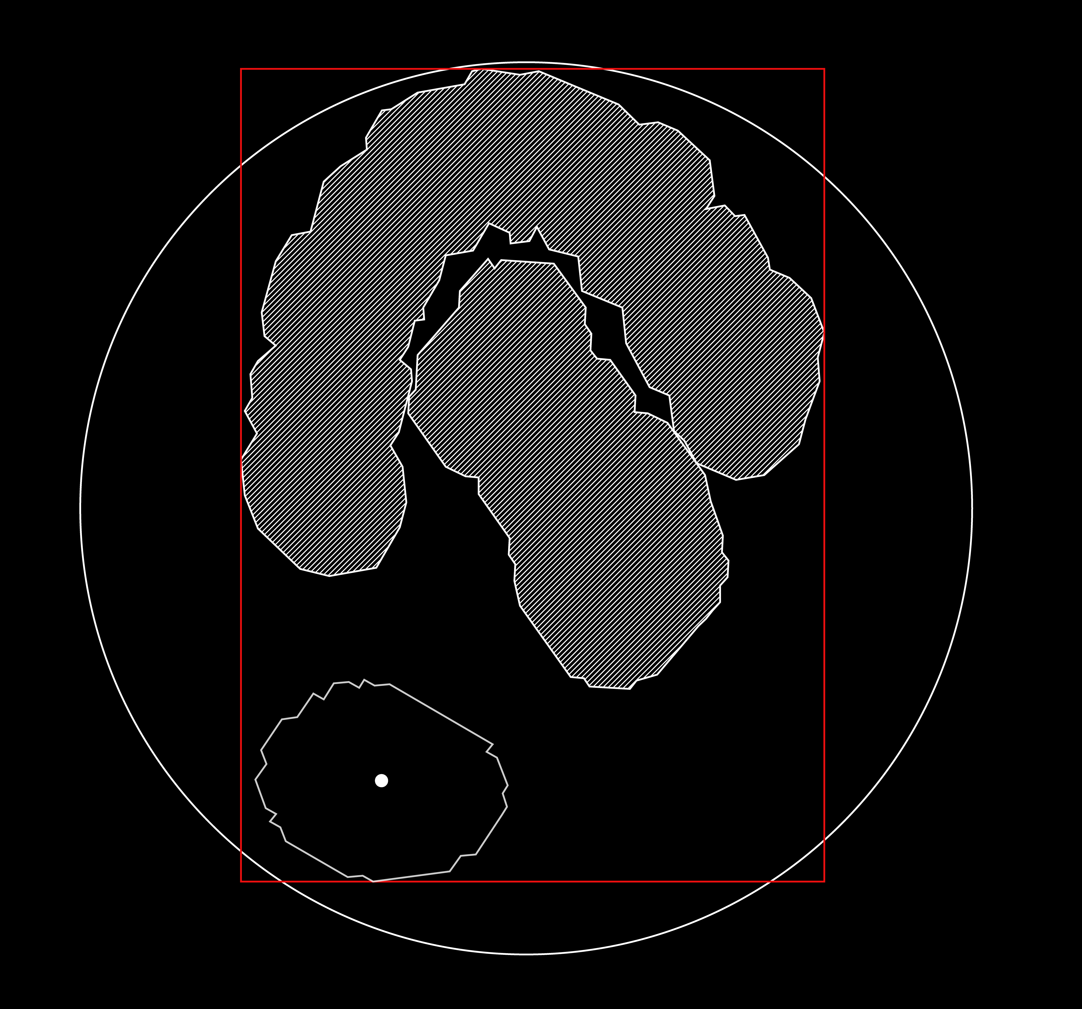

The nesting problem
Define the Nesting Problem in terms of minimizing a function
Given:
a base
some objects already nested, balk
a new object to nest in a certain position and with a certain orientation
Determine the global bounding box
$$(x_{o }, y_{o }, θ)$$

Slide 20
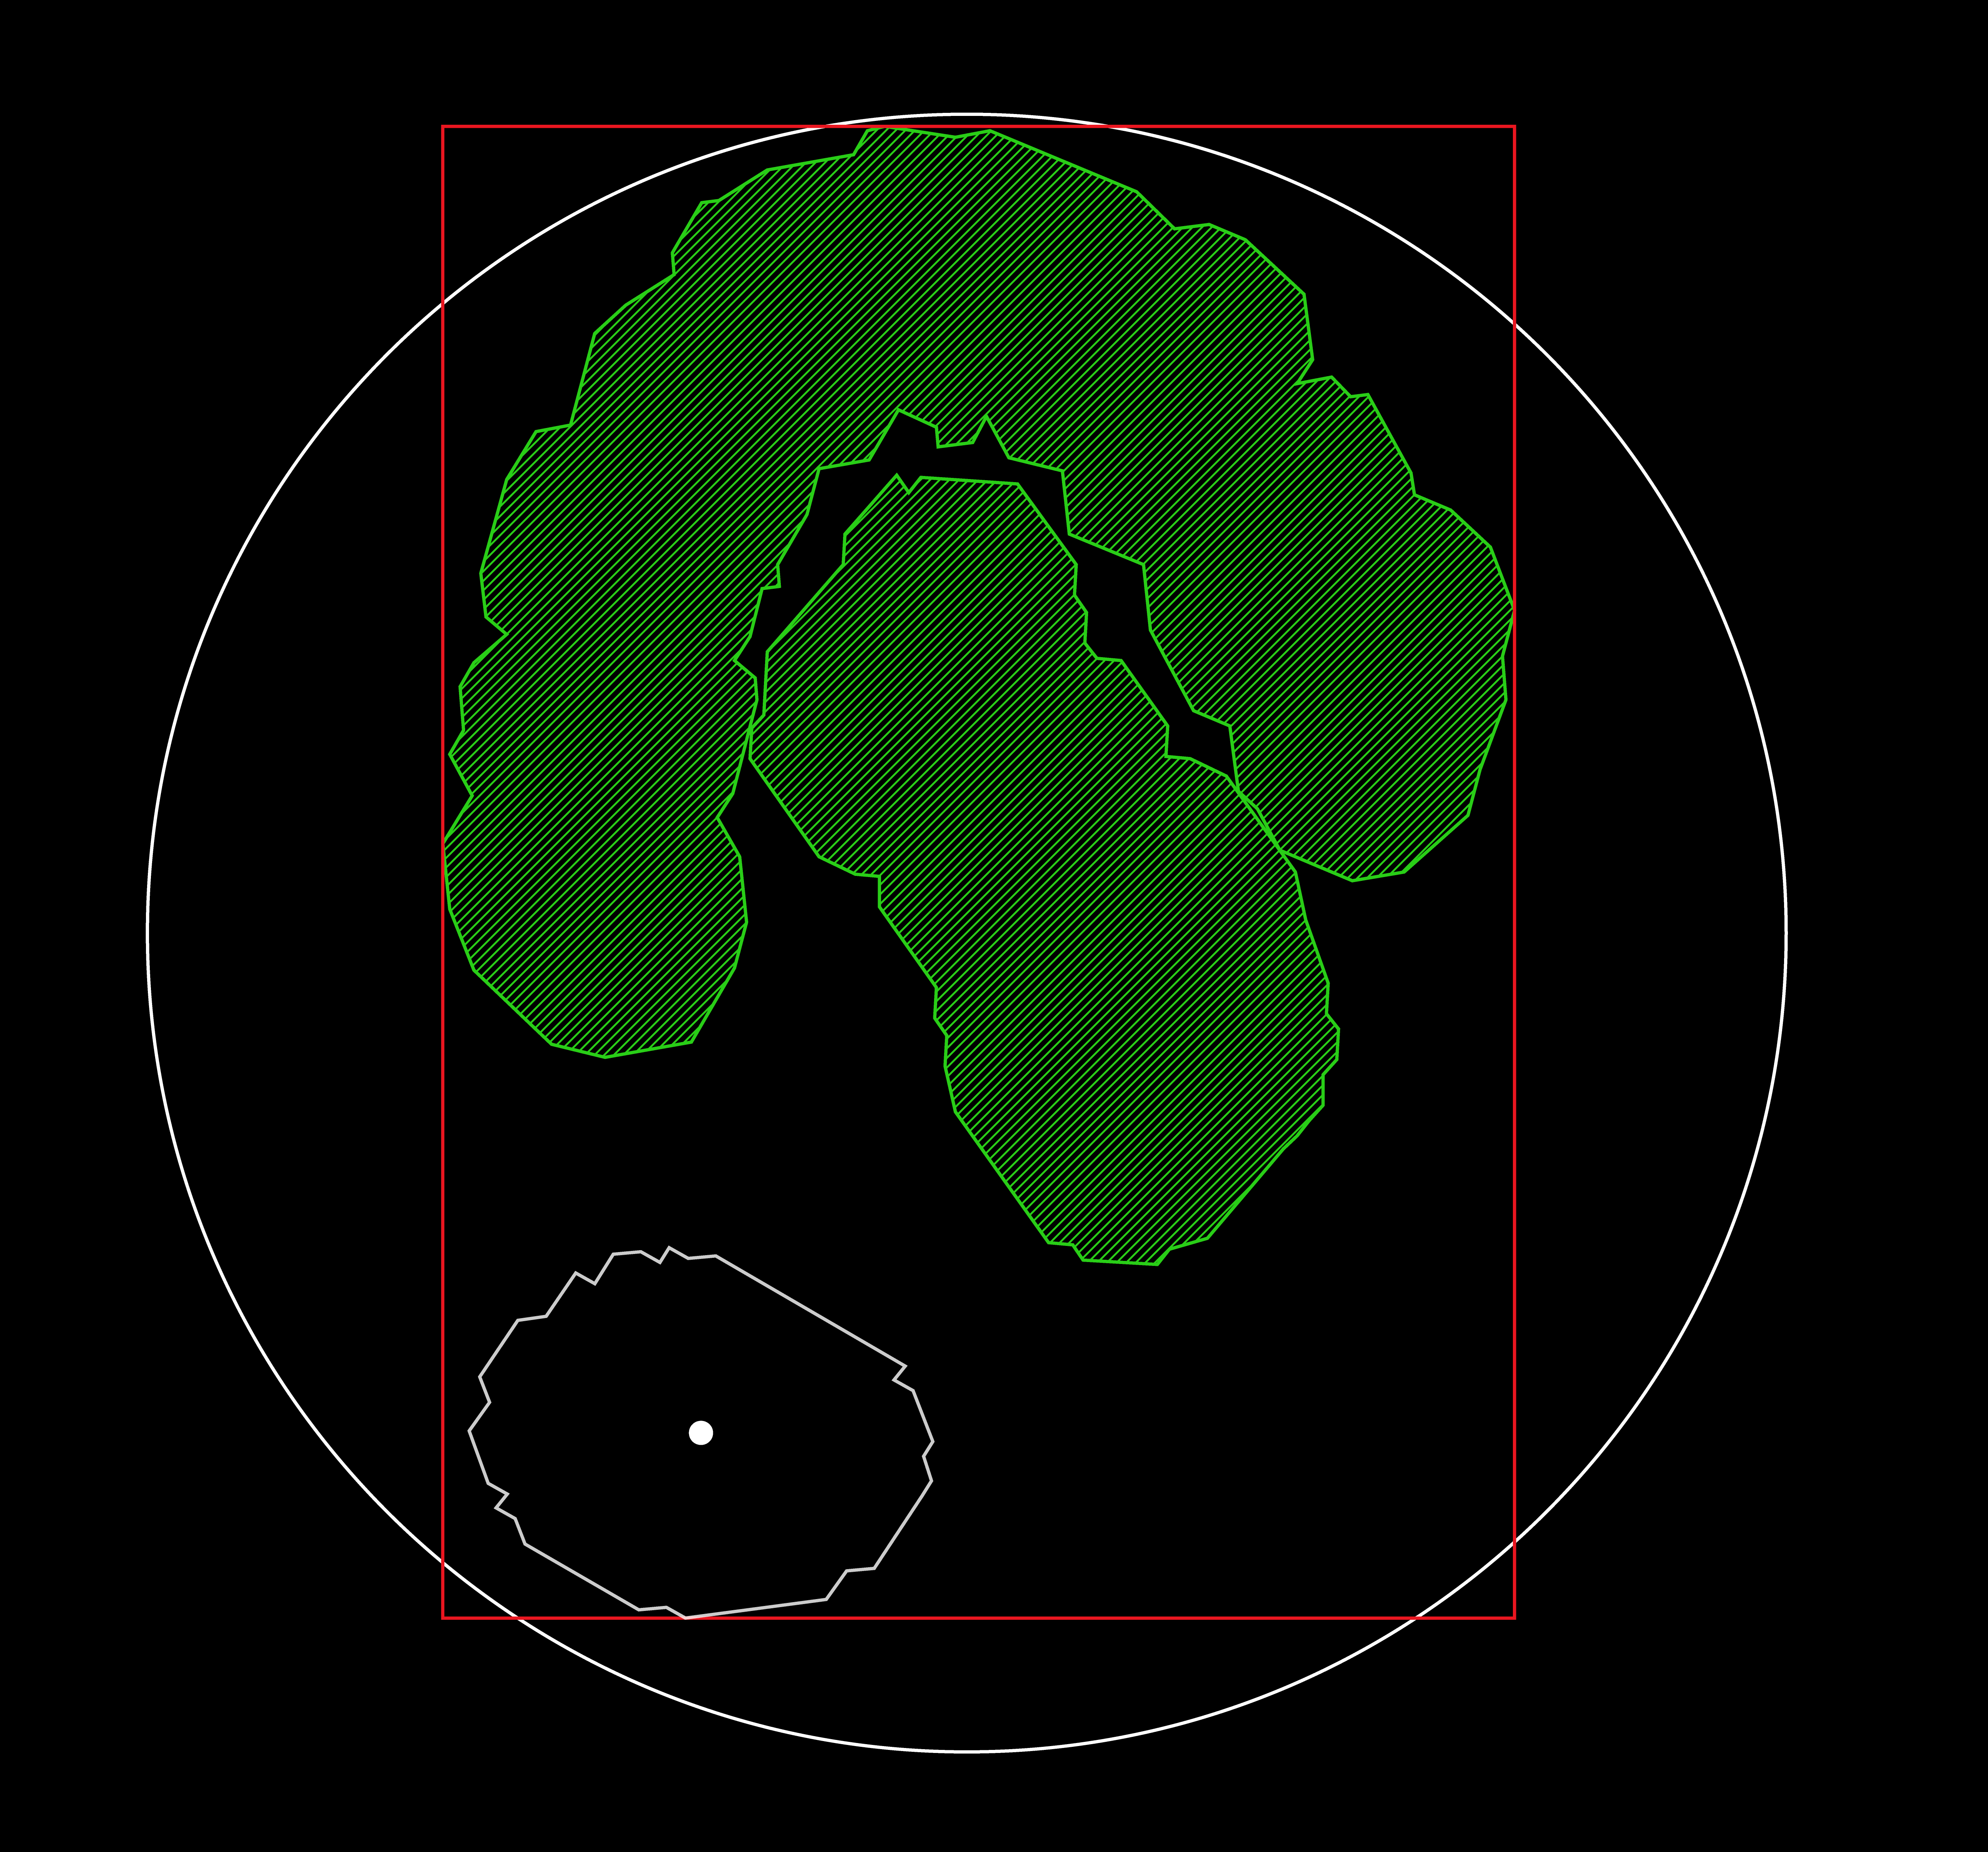
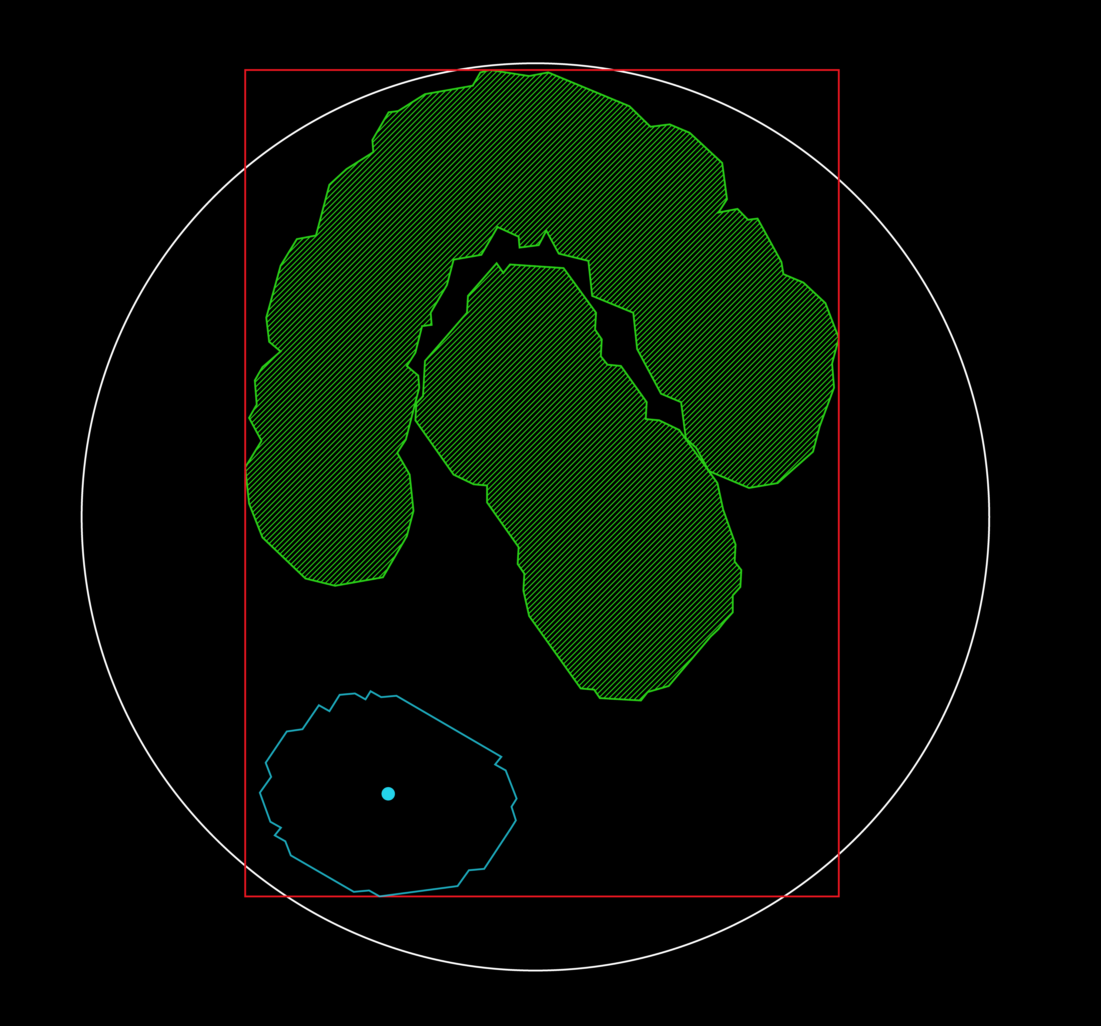
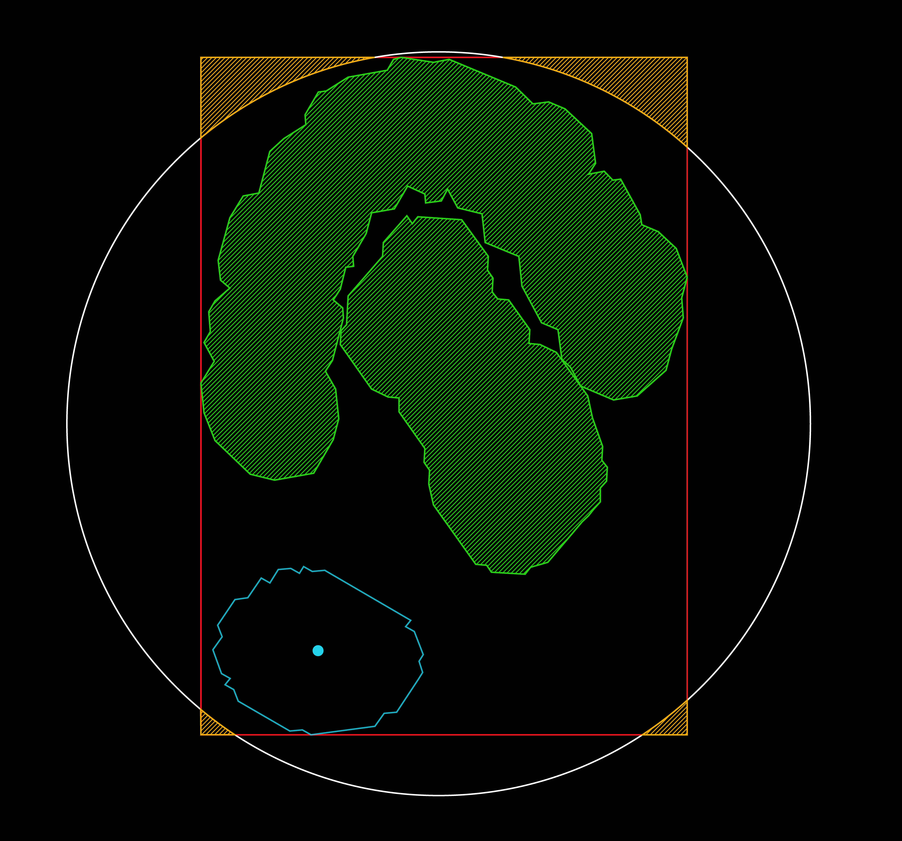

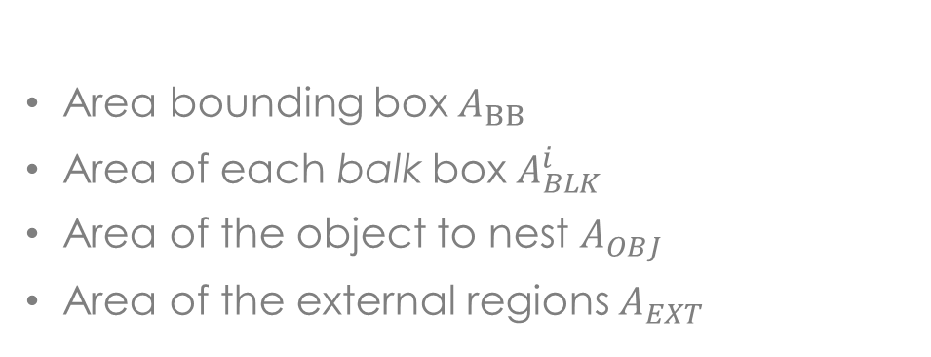
The nesting problem
Given $\left(x_{o }, y_{o }, θ\right)$ I need to calculate:
Area bounding box $A_{BB }$
Area of each balk box $A_{BLK}^{i}$
Area of the object to nest $A_{OBJ}$
Area of the external regions $A_{EXT}$
The function to minimize is:
$$M=\frac{A_{BB}−\sum_{i}{A_{BLK}^{i}}−A_{OBJ}−A_{EXT}}{A_{BB}}$$

Slide 21
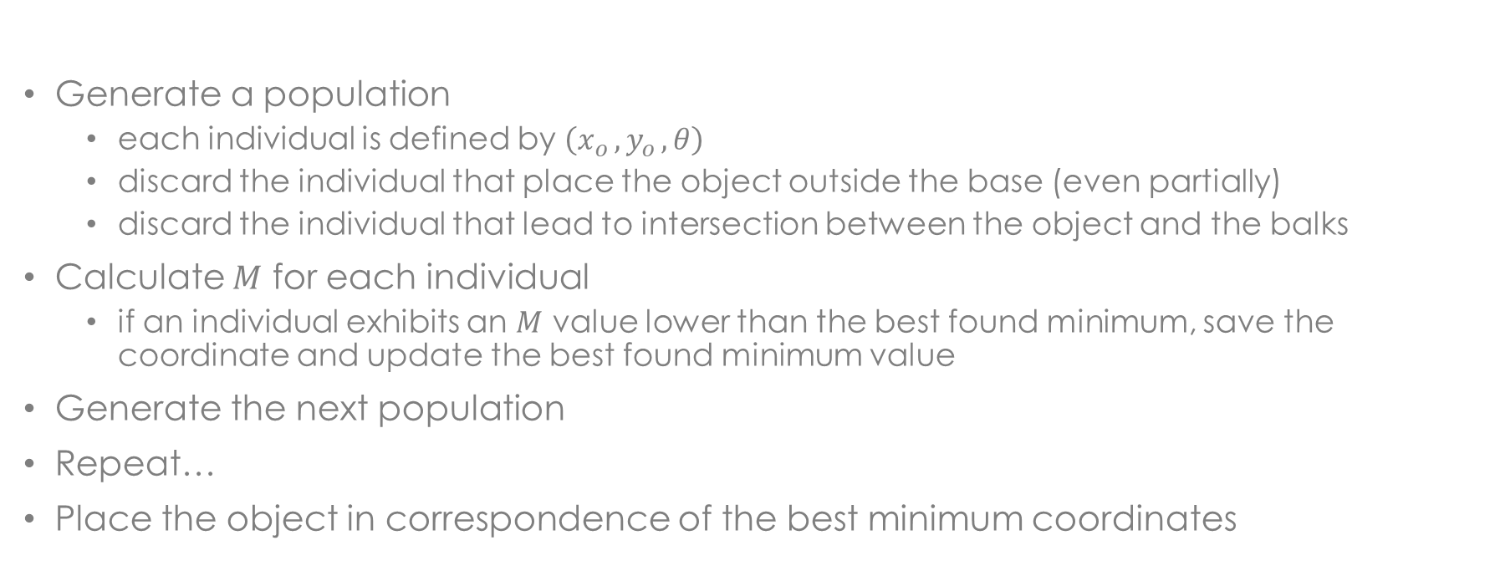
The nesting problem
Nest a single object:
Generate a population
each individual is defined by $\left(x_{o }, y_{o }, θ\right)$
discard the individual that place the object outside the base (even partially)
discard the individual that lead to intersection between the object and the balks
Calculate $M$ for each individual
if an individual exhibits an $M$ value lower than the best found minimum, save the coordinate and update the best found minimum value
Generate the next population
Repeat…
Place the object in correspondence of the best minimum coordinates

Slide 22


The nesting problem
Nest all the objects:
Nest a single object
Update the base (the nested object became a new balk)
Repeat…
IMPROVMENTS:
Combine different functions to minimize $M=λ_{0}M_{0}+λ_{1}M_{1}+…+λ_{n}M_{n}$
Object recognition

Slide 23

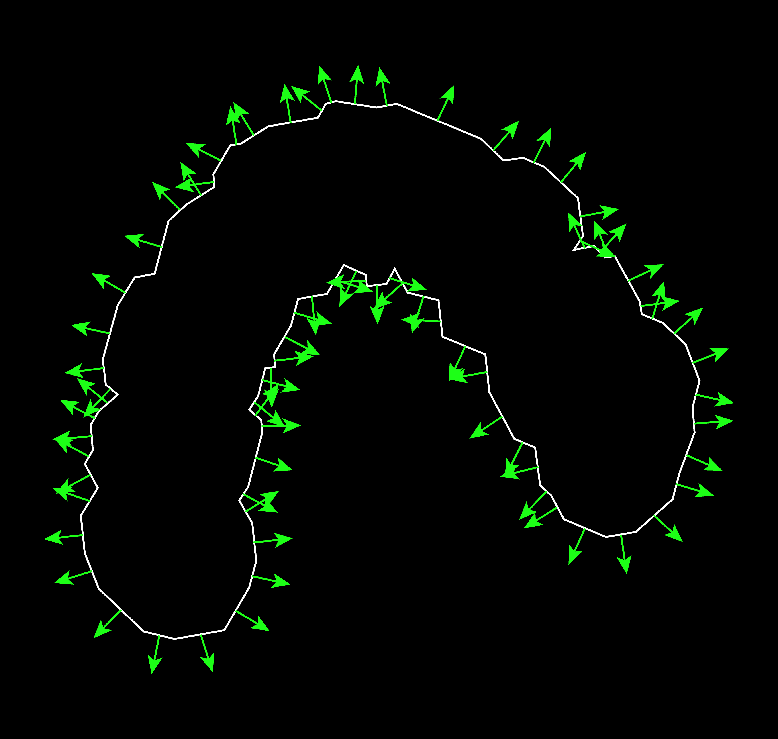
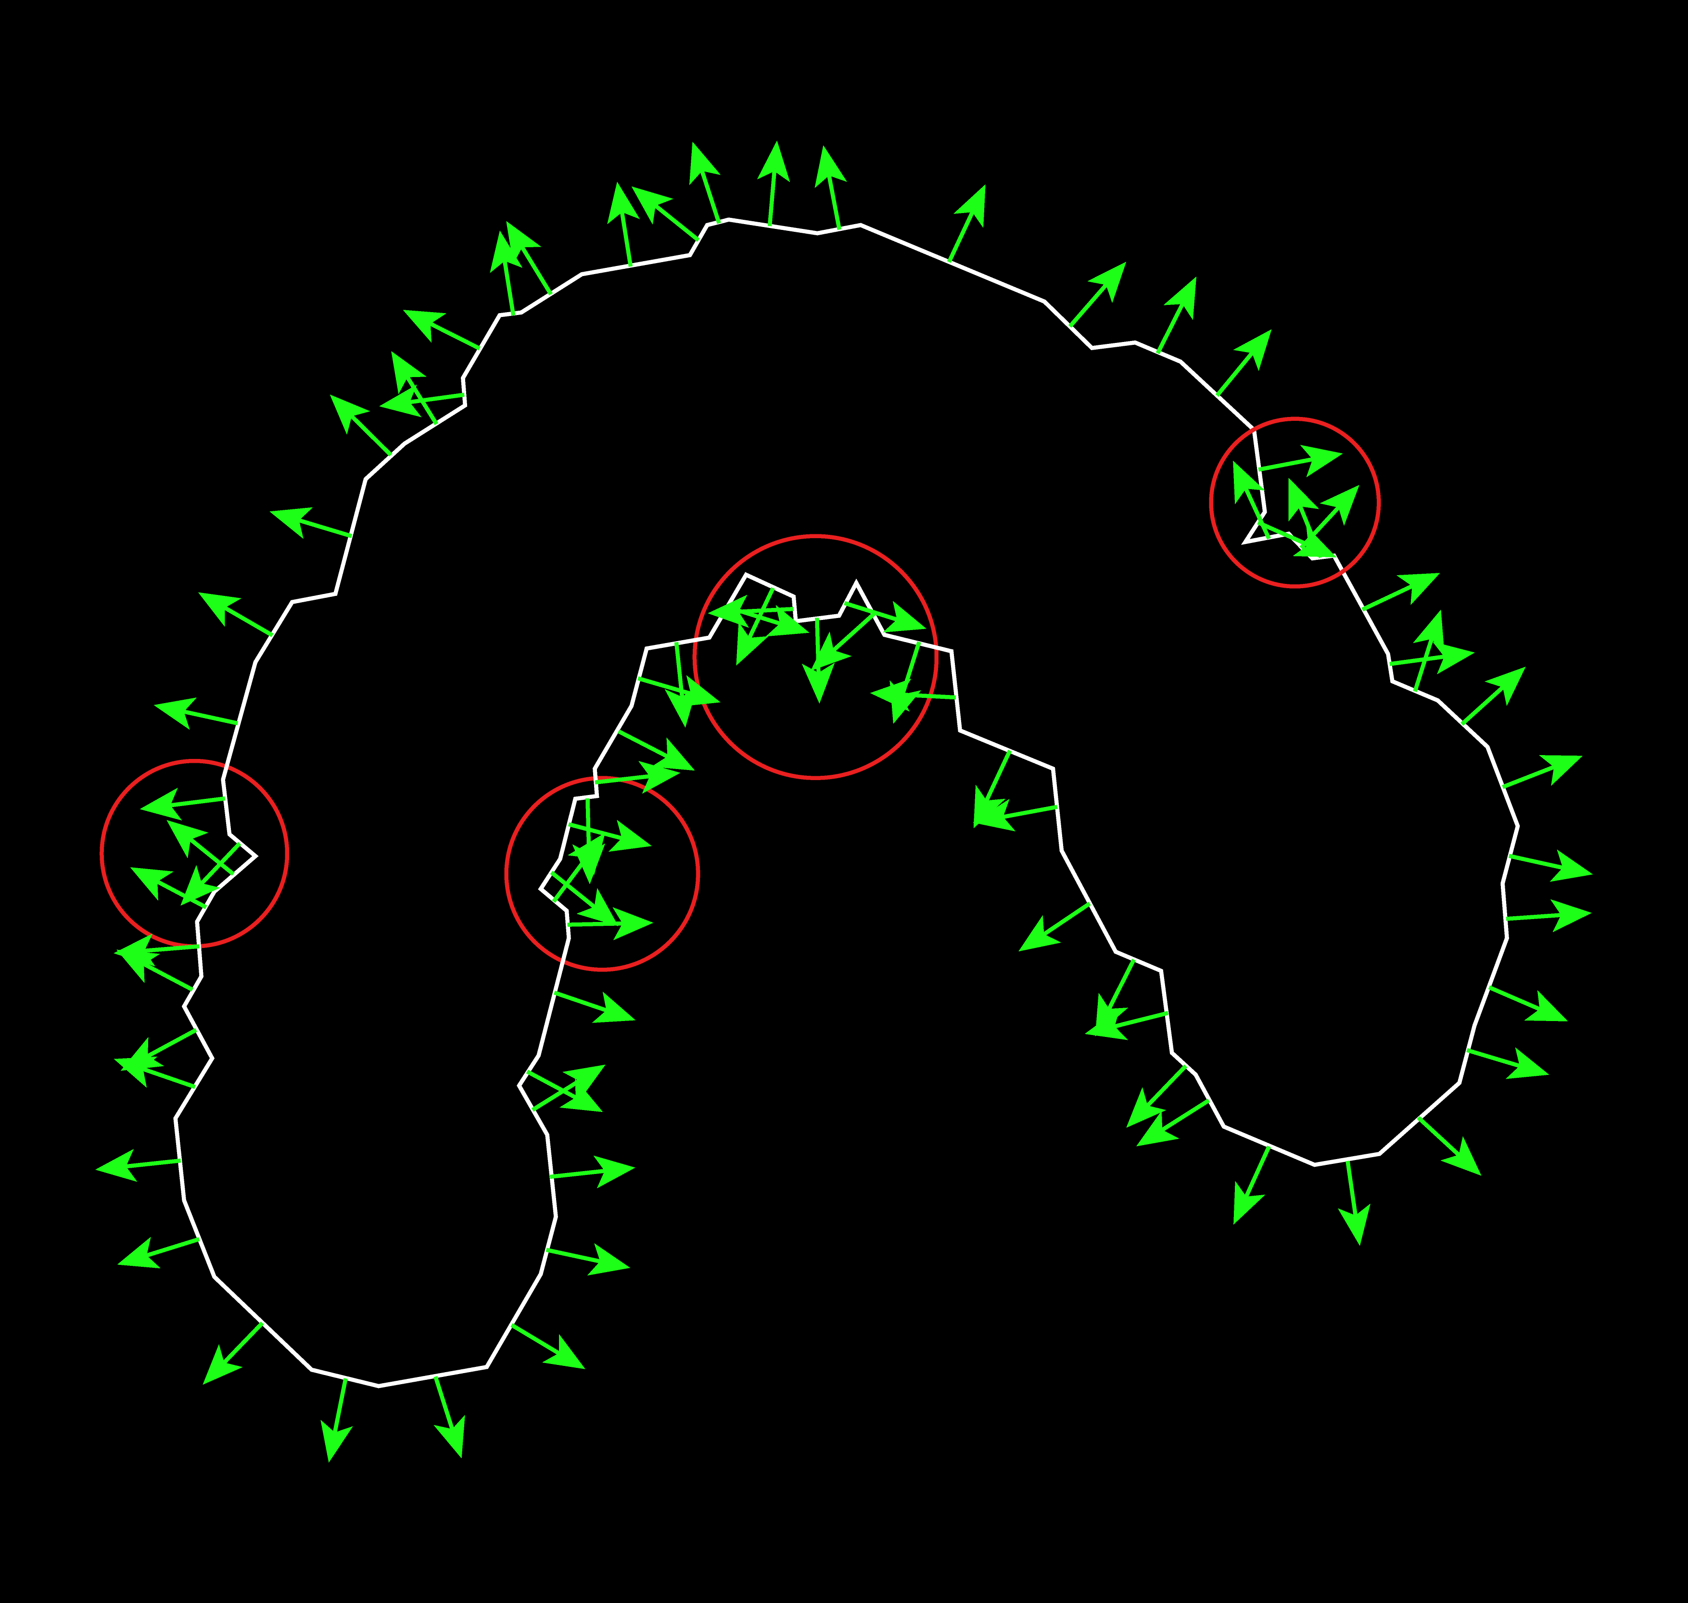
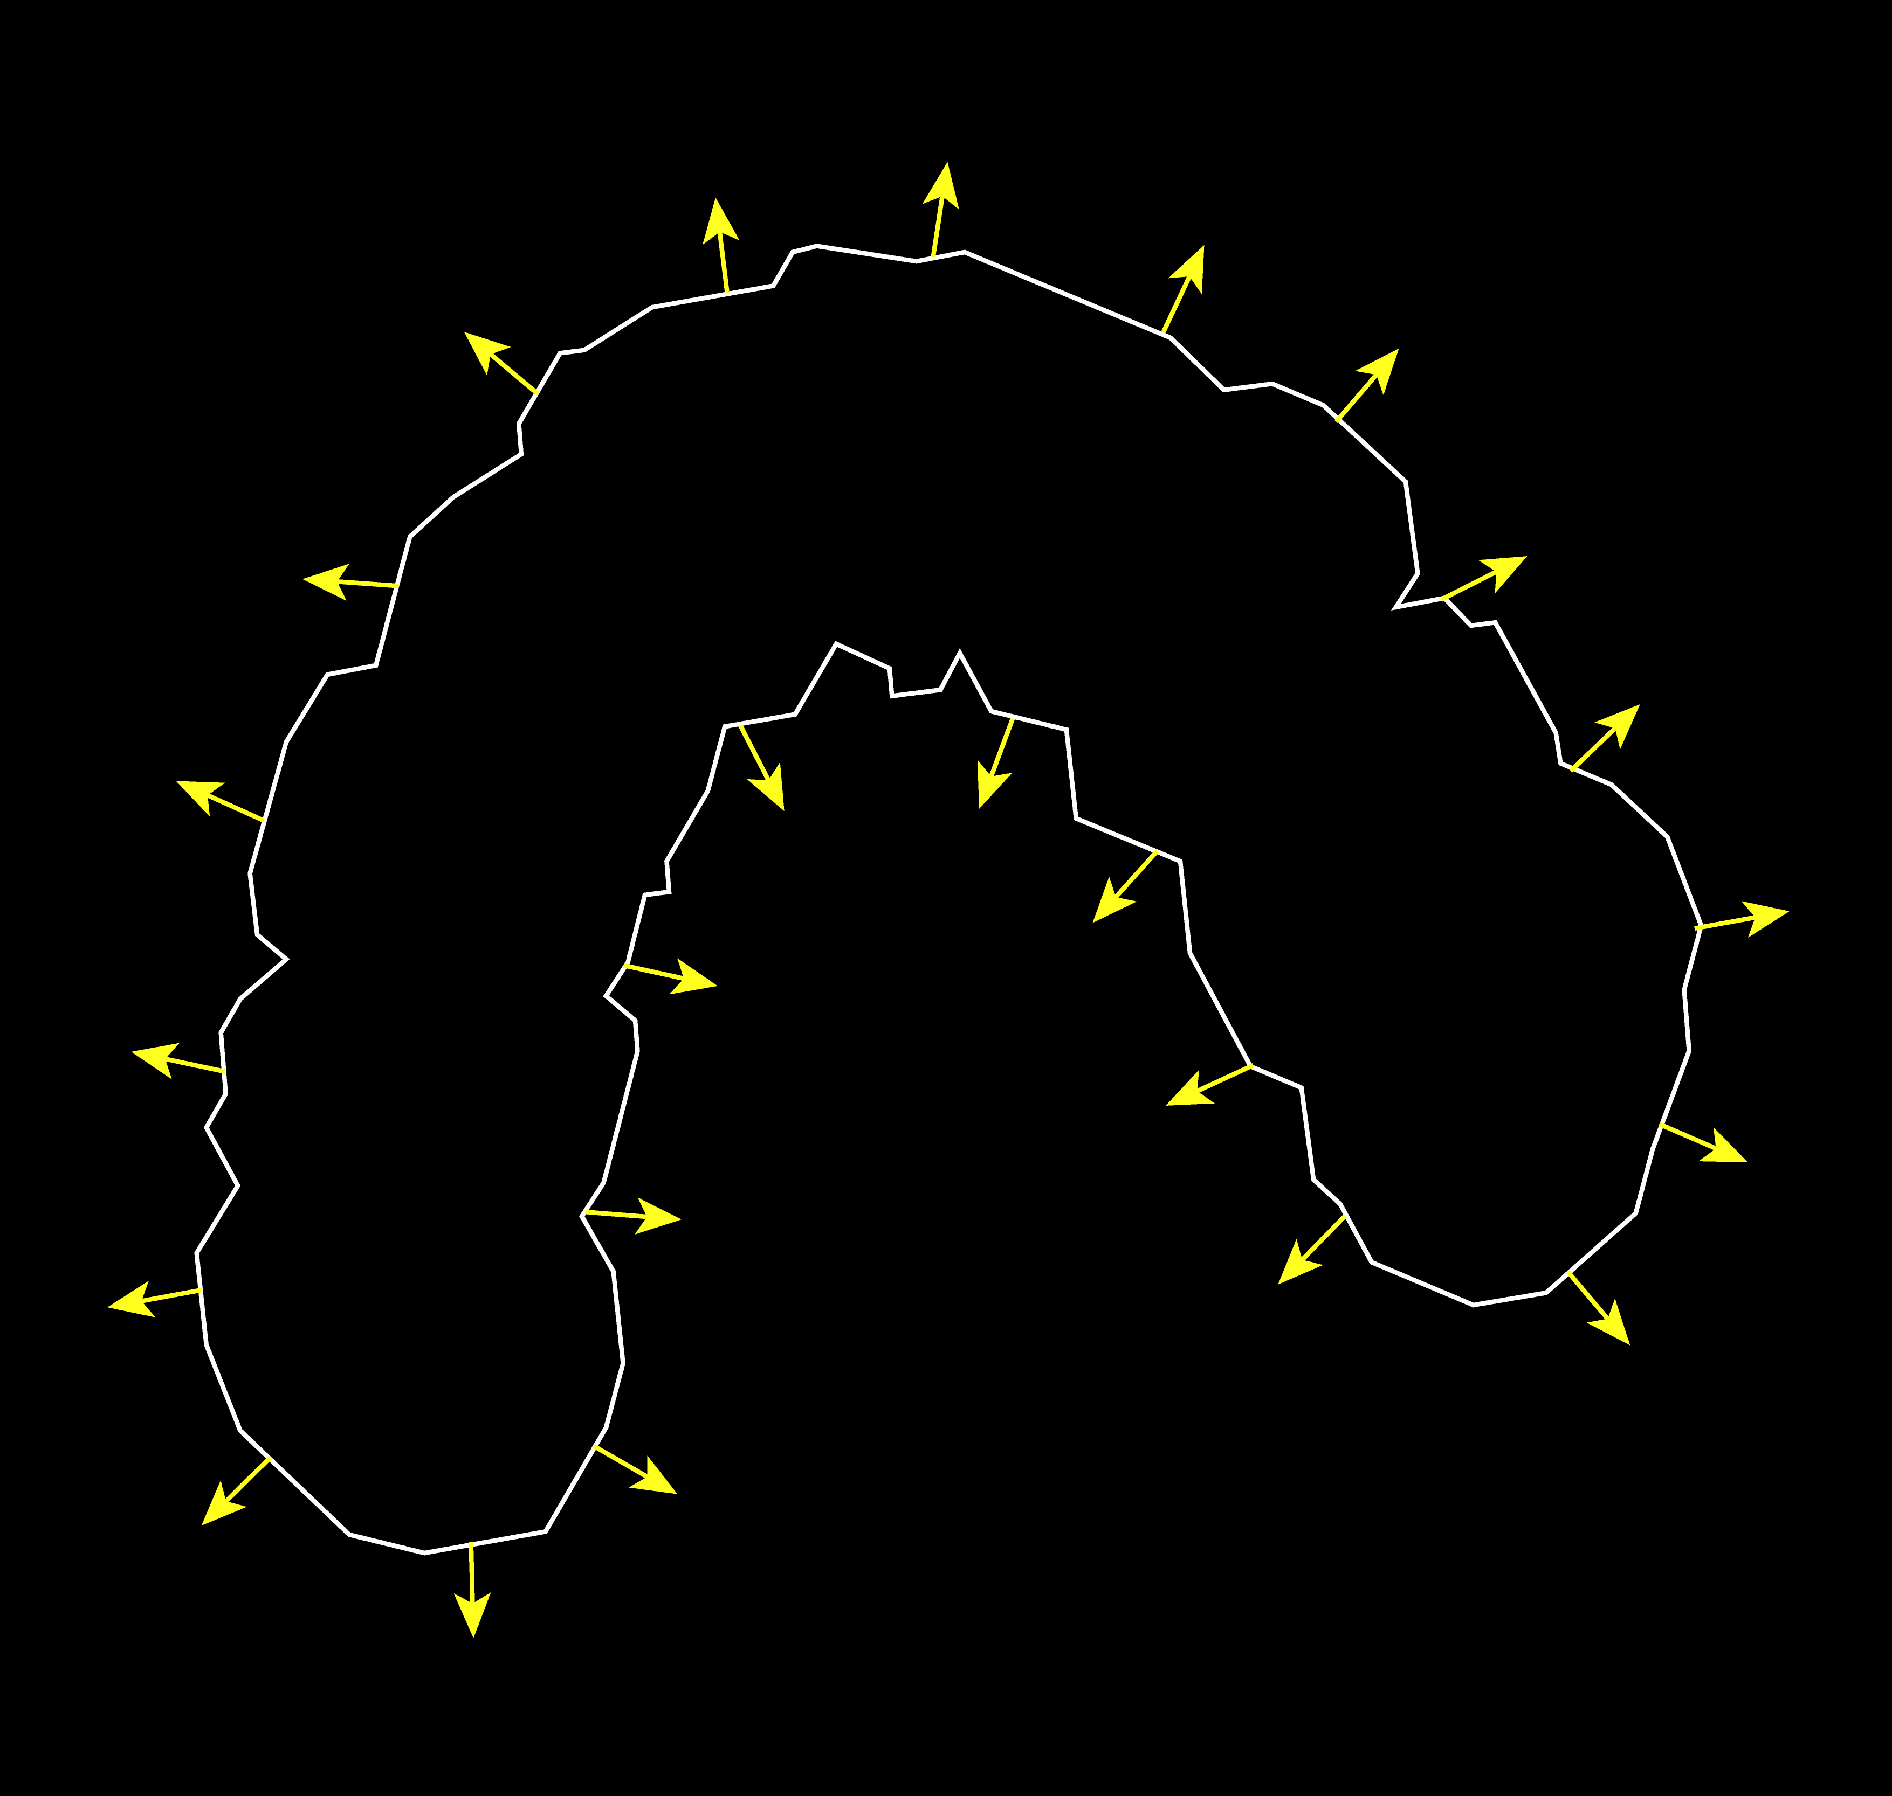
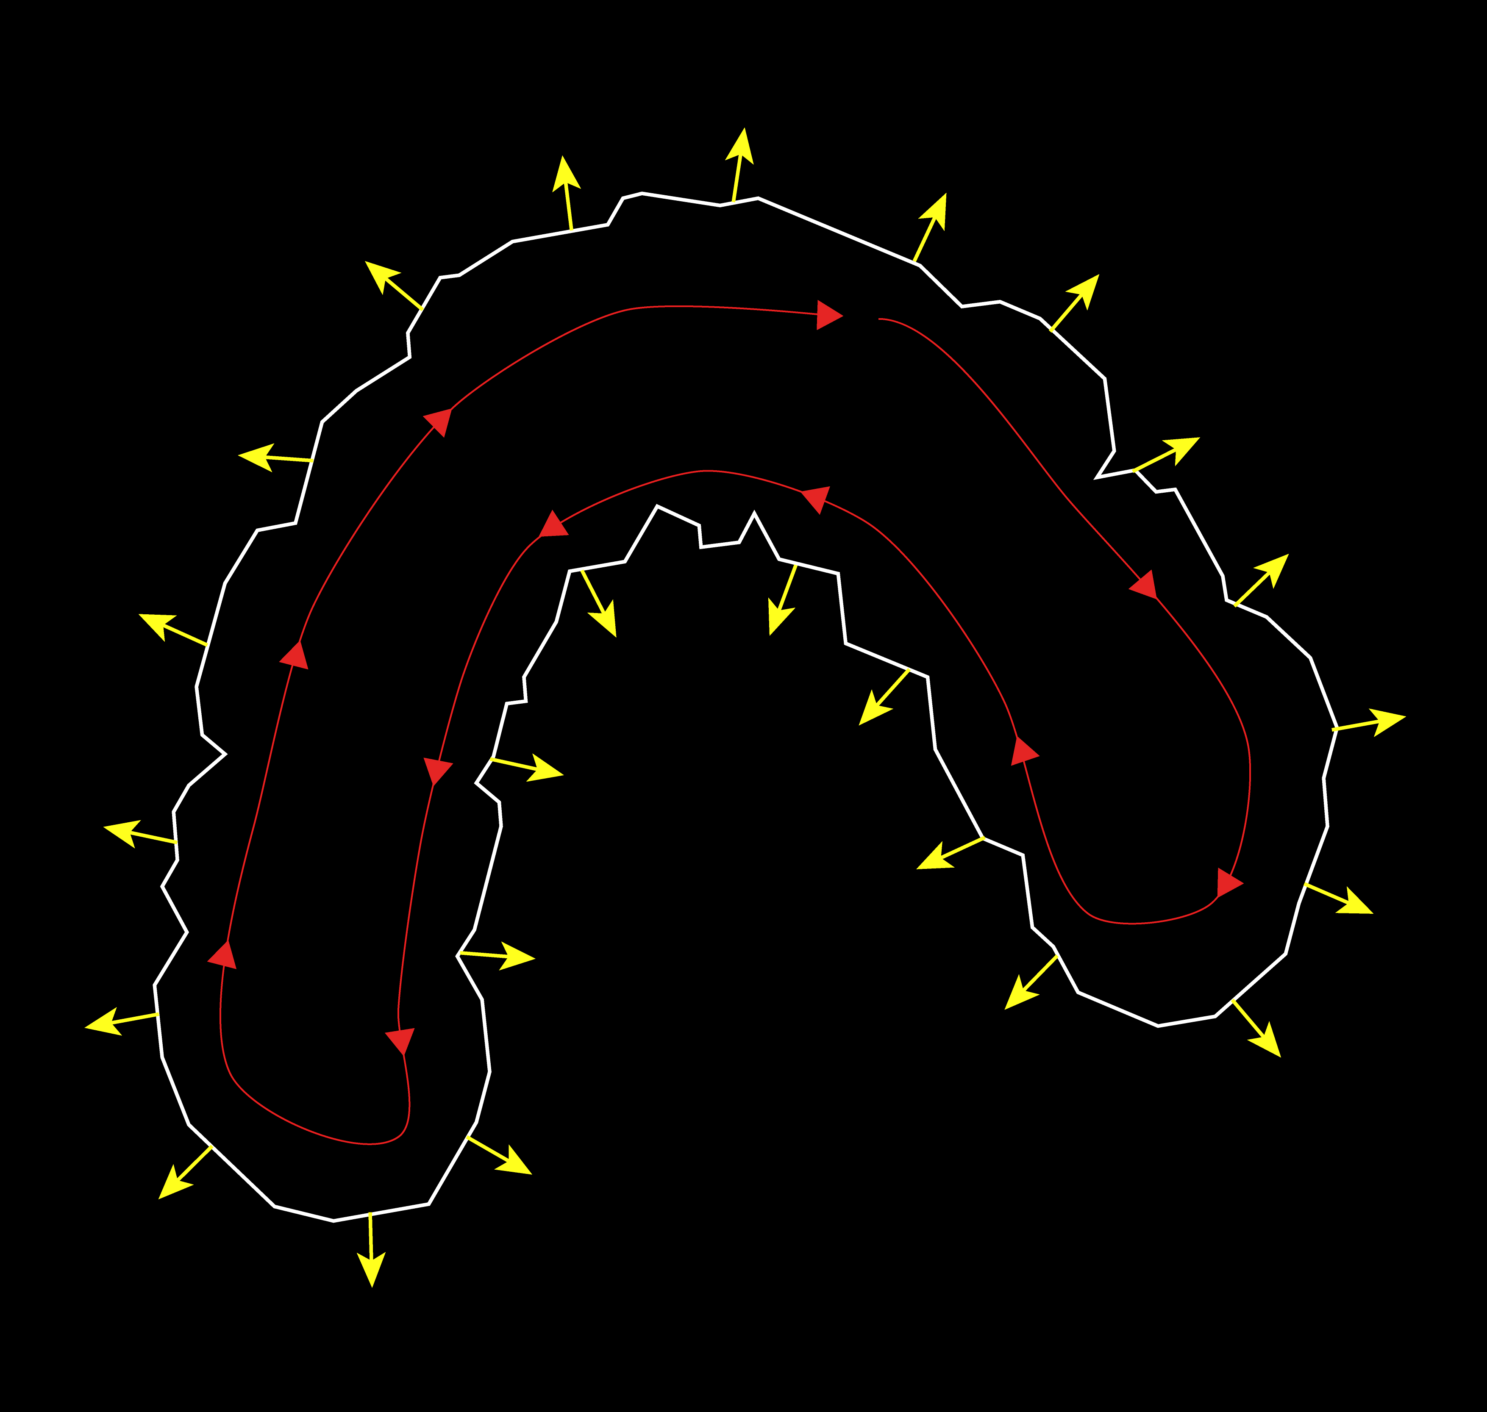
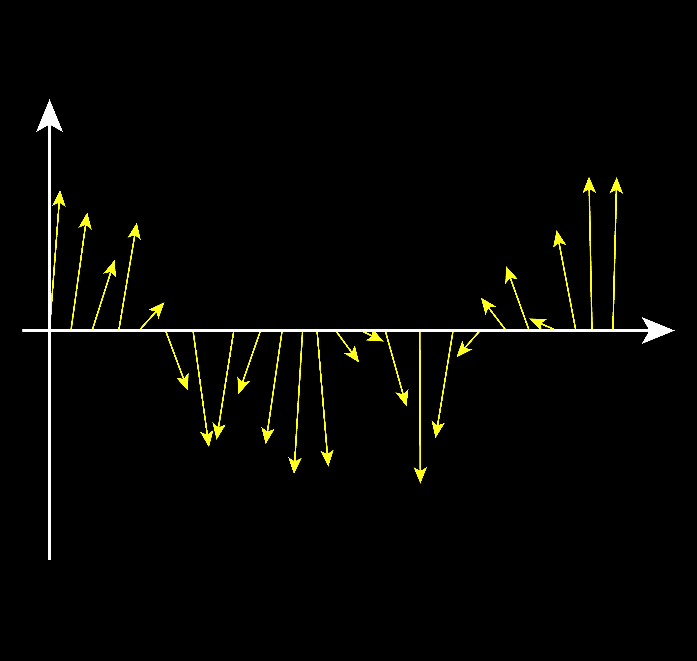
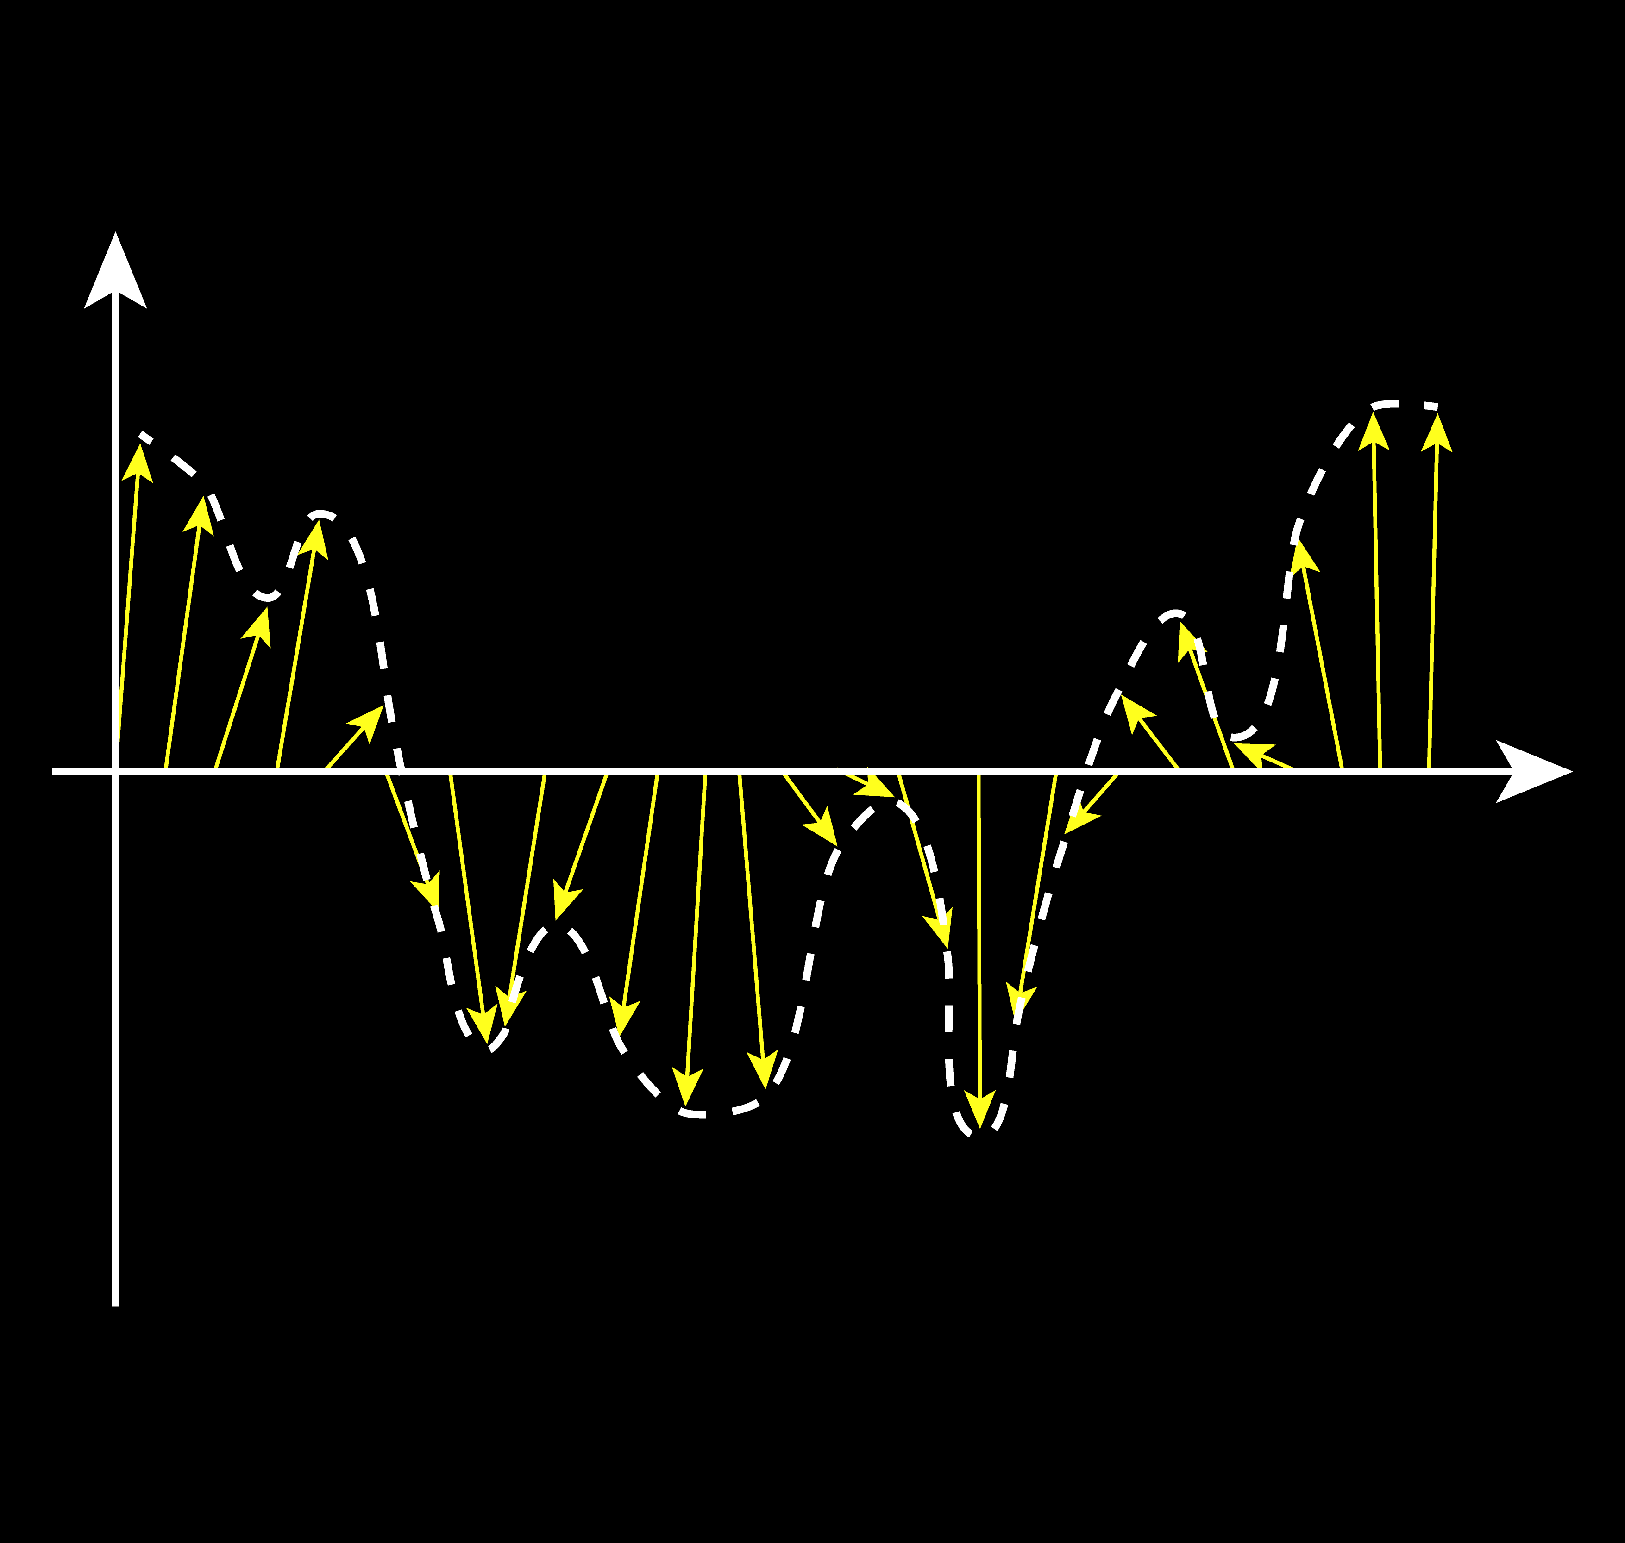
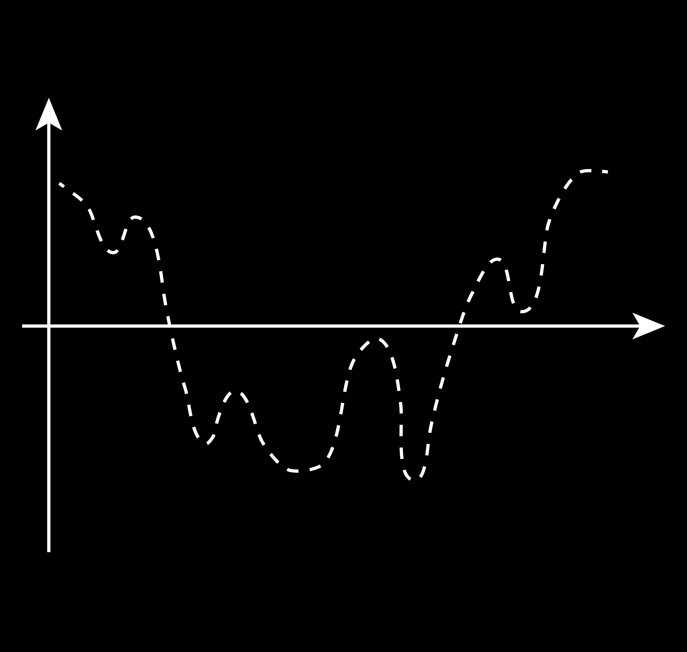


Object recognition
Given the profile of an object:
Calculate edge normals
Reduce the number of normals
Set and order to the sequence of normals
Represent the normal sequence as a curve
$$y$$
$$x$$
FOURIER TRANSFORM

Slide 24
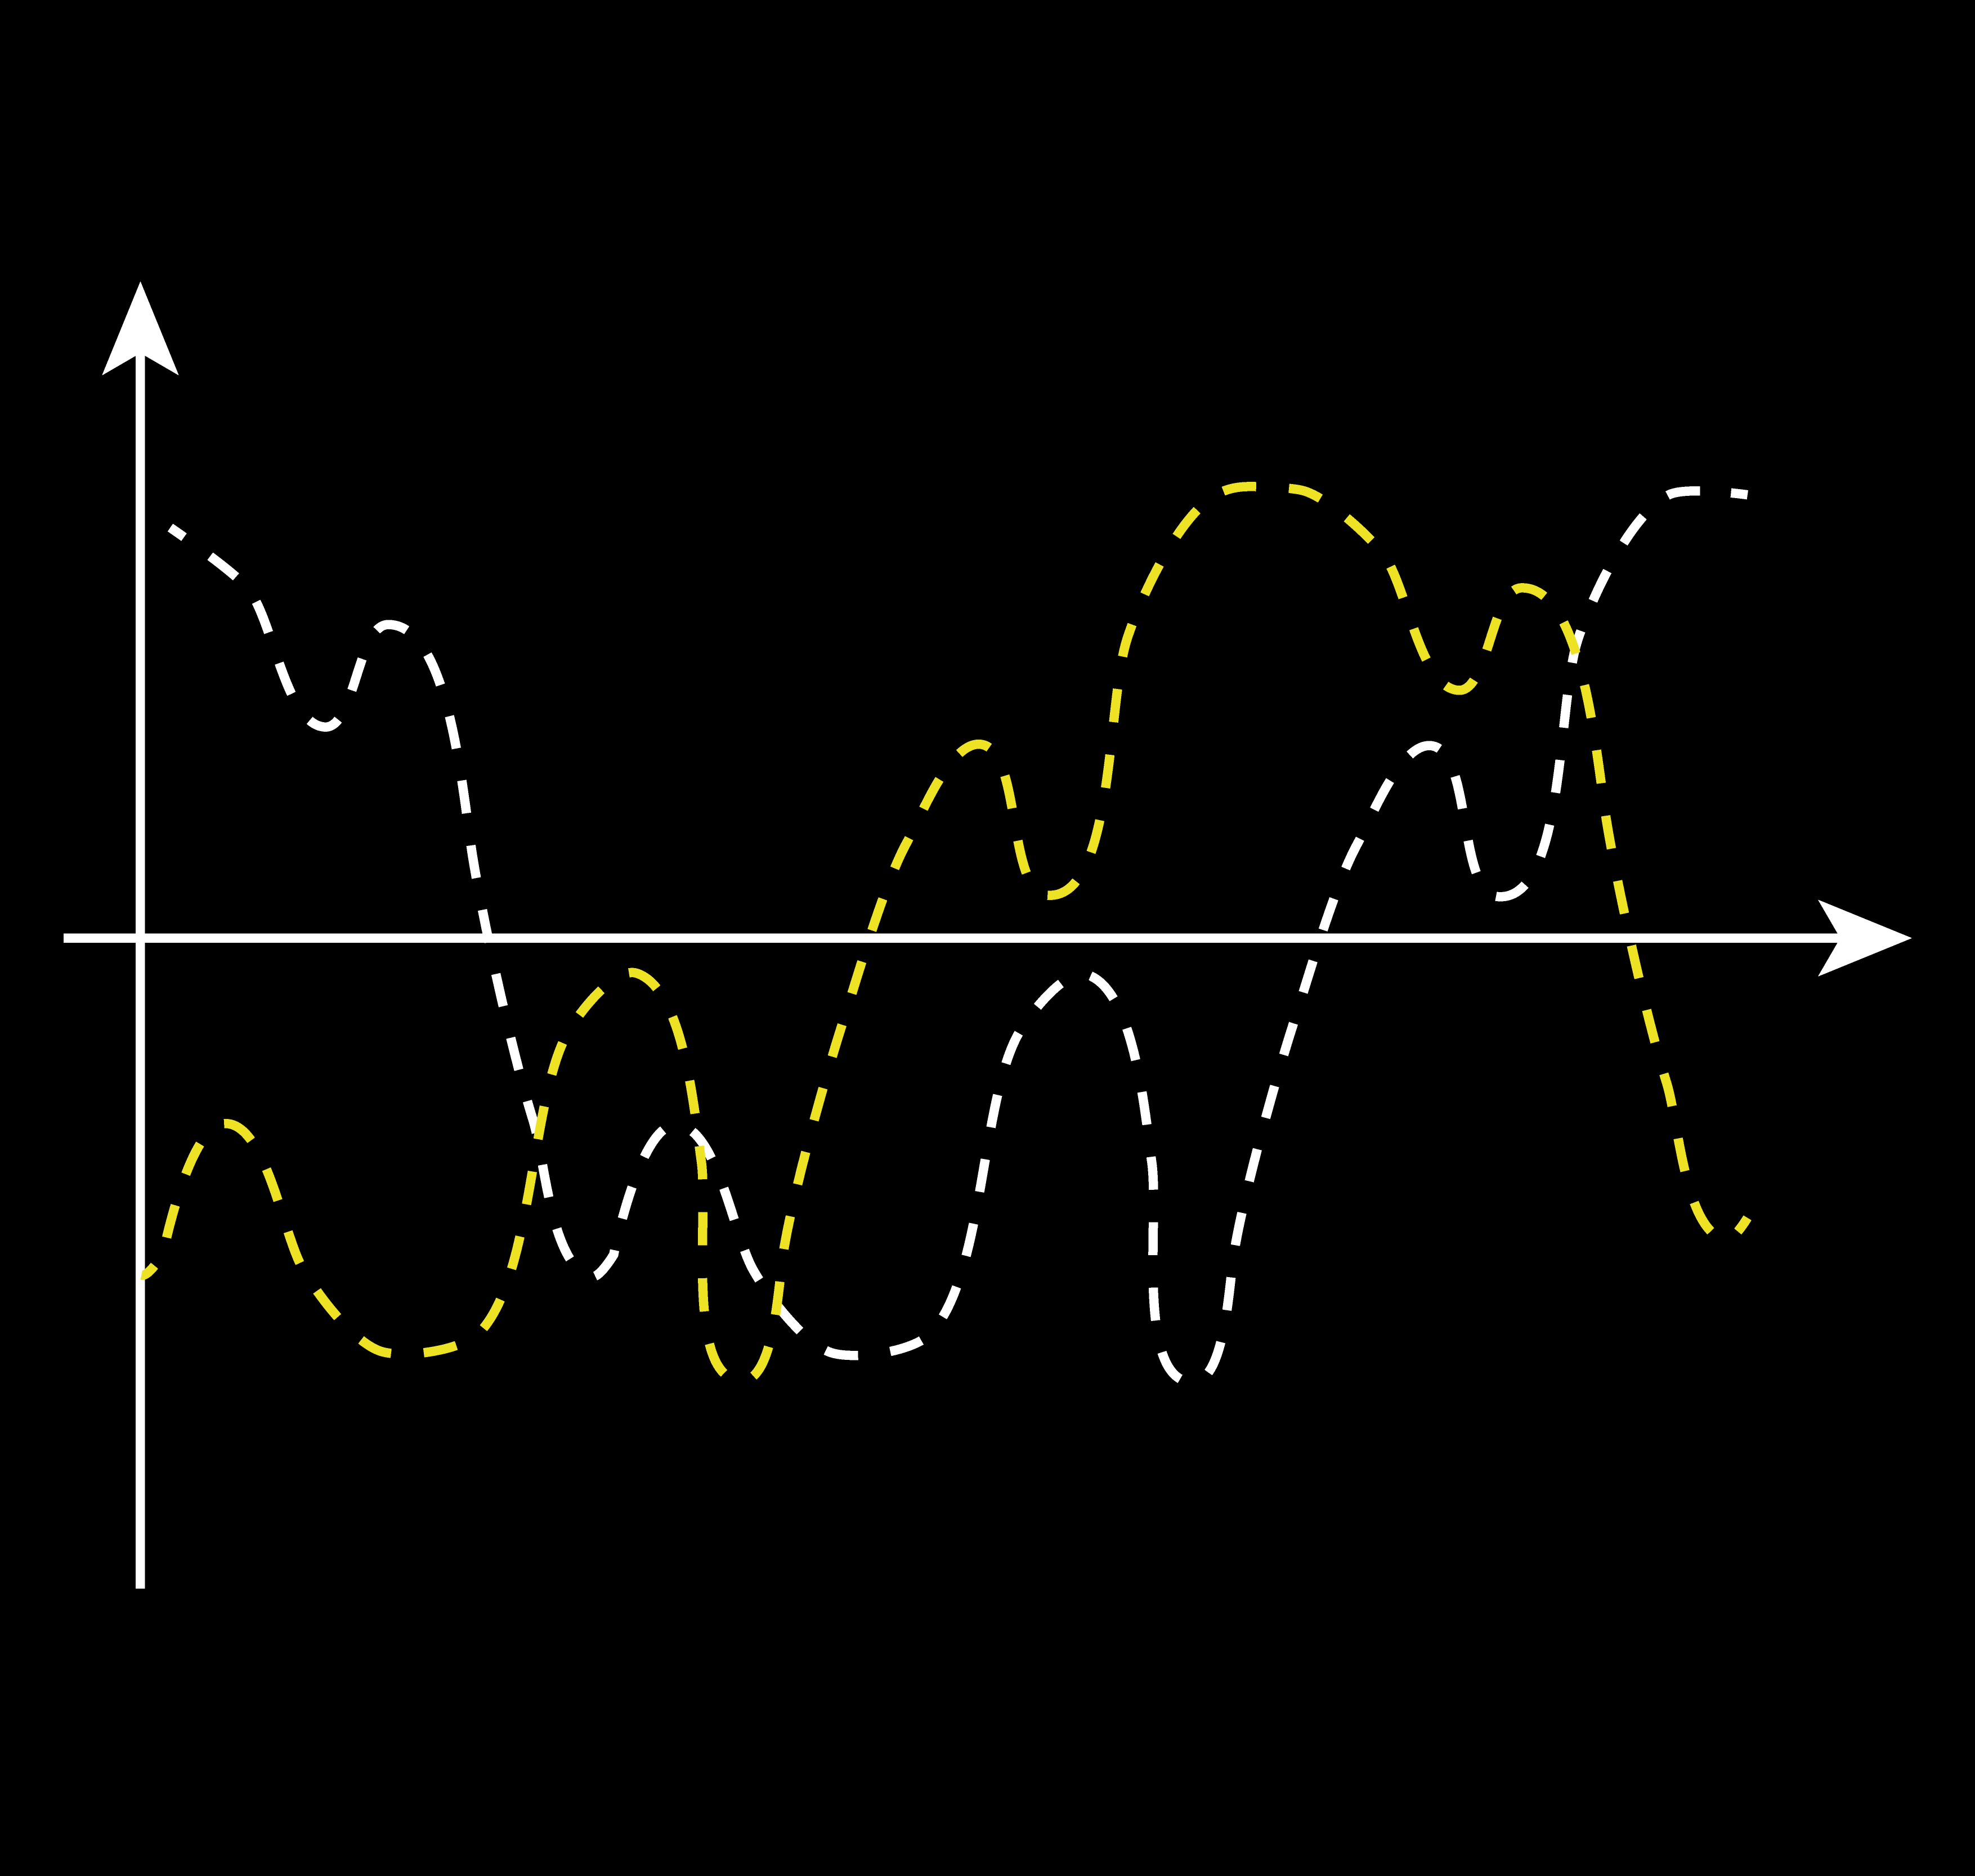
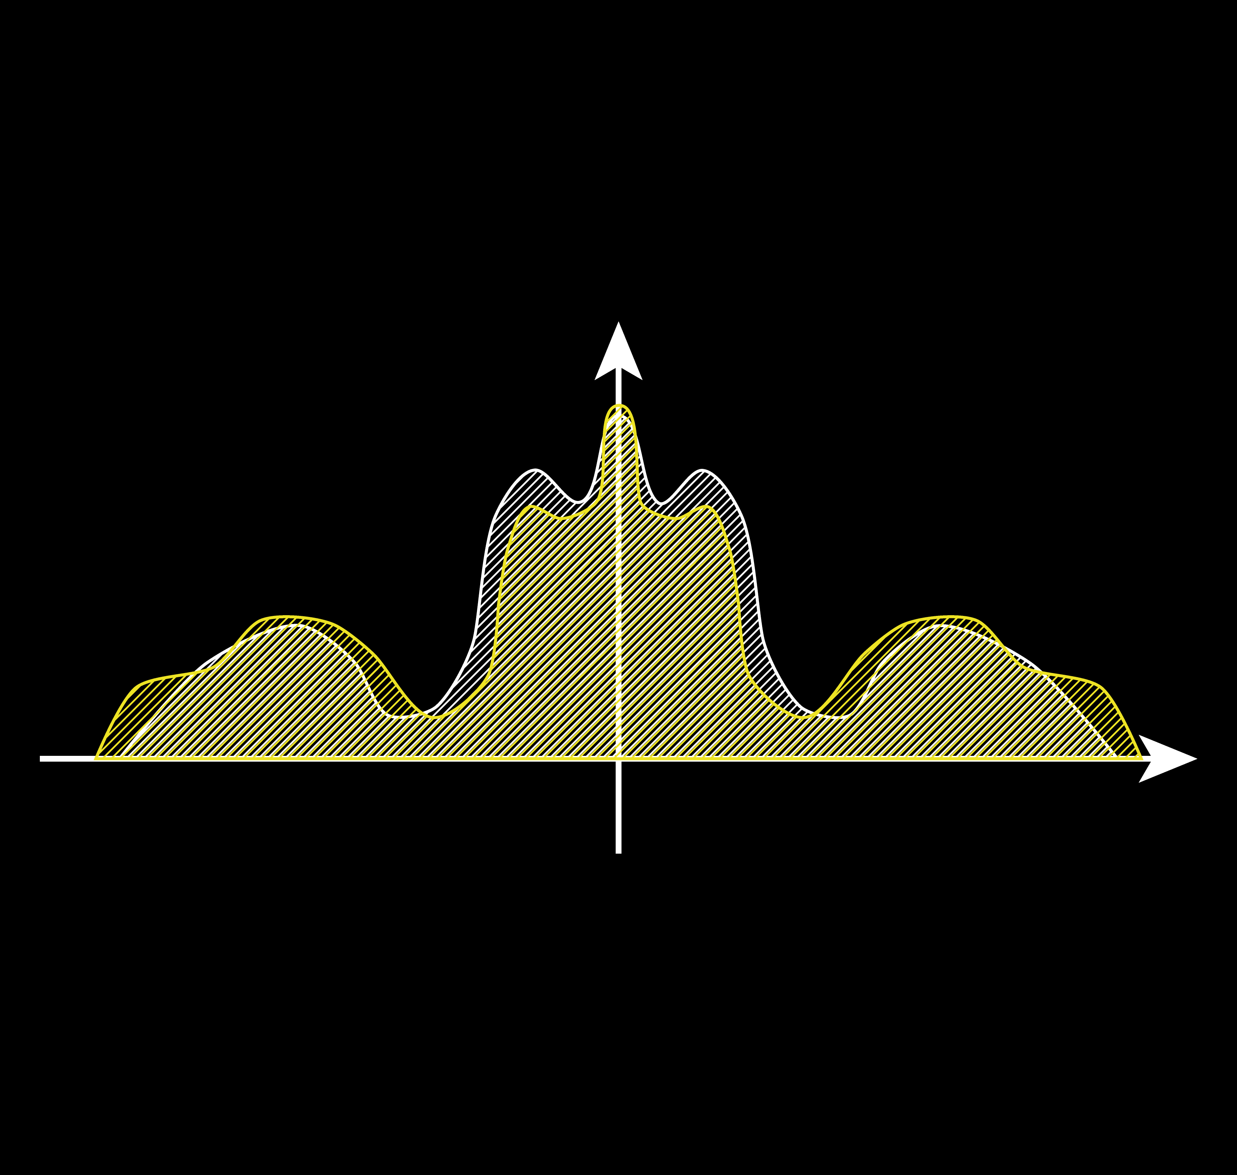


Object recognition
$$y$$
$$y′$$
$$x$$
$$f$$
DFT

Slide 25

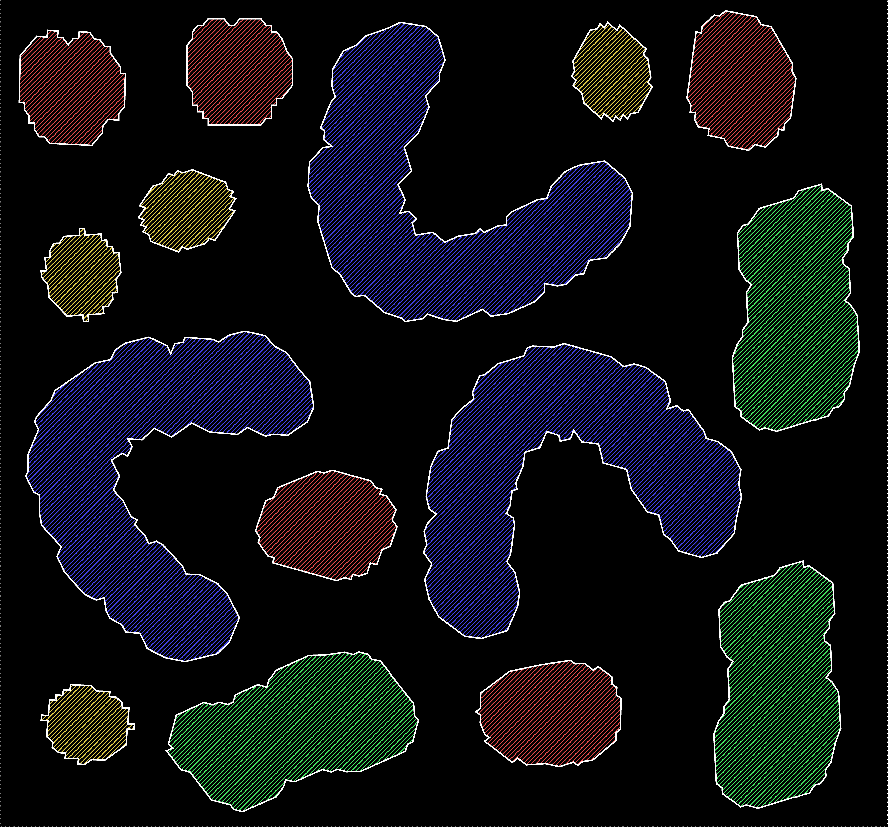
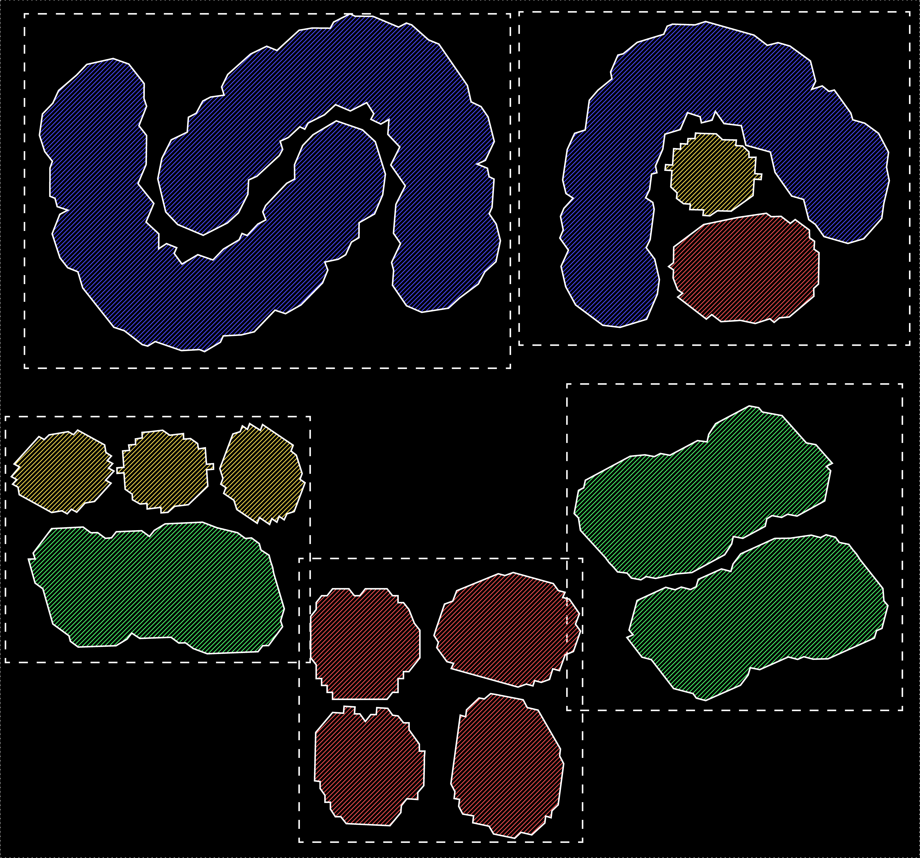
Nesting and machine learning
Categories:
Circular small
Circular mid
Ellipsoidal
C-shaped

Slide 26

acknowledgements
SPECIAL THANKS
Silvio De Angelis and Riccardo Villa from Vyde
Stefano Scuratti, Denny Menato and the Pyramis team (Luca Masone and Riccardo Turati) from CIM System

Slide 27
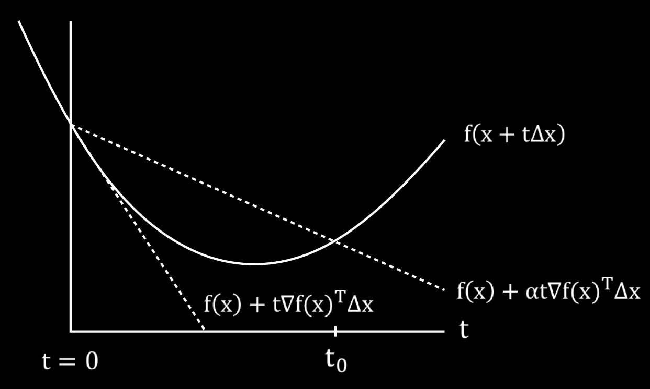



Supp – backtracking line search
Goal: determine the optimal value of t
Pseudo-code:
$t=1$
while $f\left(x+t∆x\right)>f\left(x\right)+αt{∇f(x)}^{T}∆x$
$t=βt$
It is assumed to be known:
Descent direction → $∆x$
Gradient of the function → $∇f(x)$
Parameters:
$α ∈(0, 0.5)$ → $0.3$
$β ∈(0, 1)$ → $0.8$

Slide 28

Supp - NUMERICAL MINIMIZATION
We are interested in evaluating the probability of acquiring a certain disease (let’s say diabetes) in dependence of some medically relevant variables (weight, age, height, blood pressure…)
The probability p spans the range [0,1] and depends on the medically variables as described by the logistic model:
$$p=\frac{e^{a^{T}u+b}}{1+e^{a^{T}u+b}}$$
where a ∈ R^{n} and b ∈ R^{n} are models parameters while u ∈ R^{n} is the vector containing the explanatory medical variables.

Slide 29

Supp - NUMERICAL MINIMIZATION
a ∈ R^{n} and b ∈ R^{n} → models parameters
u ∈ R^{n} → medical variables
We assume that u represents the weight of a patient
We have already acquired several data
$$p=\frac{e^{a^{T}u+b}}{1+e^{a^{T}u+b}}$$
i [patient] | u_{i} [weight] | y_{i} [has diabetes]
0 | 75 | 1
1 | 50 | 0
… | … | …
N - 1 | 120 | 1

Slide 30
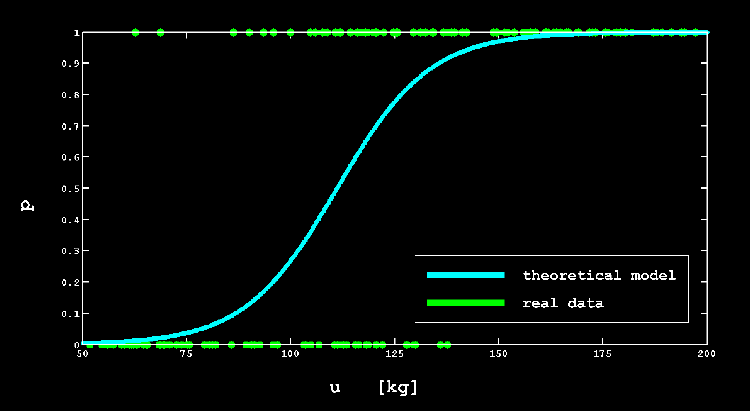

Supp - NUMERICAL MINIMIZATION
$$p=\frac{e^{a^{T}u+b}}{1+e^{a^{T}u+b}}$$
a ∈ R^{n} and b ∈ R^{n} → models parameters
u ∈ R^{n} → medical variables

Slide 31
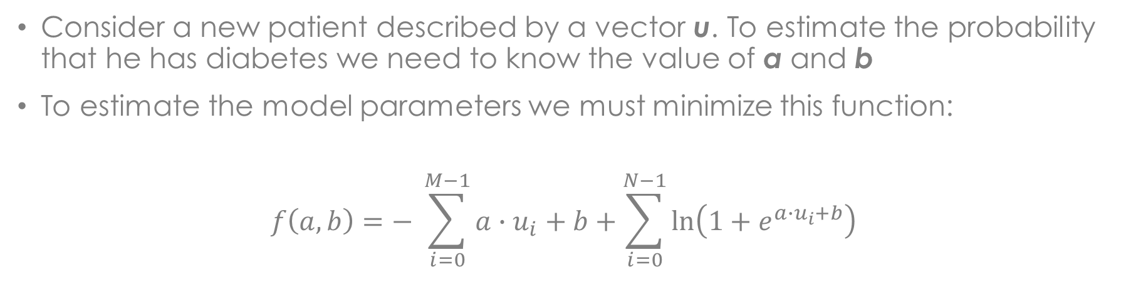
Supp - NUMERICAL MINIMIZATION
$$p=\frac{e^{a^{T}u+b}}{1+e^{a^{T}u+b}}$$
a ∈ R^{n} and b ∈ R^{n} → models parameters
u ∈ R^{n} → medical variables
Consider a new patient described by a vector u. To estimate the probability that he has diabetes we need to know the value of a and b
To estimate the model parameters we must minimize this function:
$$f\left(a,b\right)=− \sum_{i=0}^{M−1}{a∙u_{i}+b}+\sum_{i=0}^{N−1}{\ln\left(1+e^{a∙u_{i}+b}\right)}$$
* $f\left(a,b\right)$ represents the log-likelihood function. More info at http://web.stanford.edu/~boyd/cvxbook/ (chapter 7)

Slide 32

Supp - NUMERICAL MINIMIZATION
$$p=\frac{e^{a^{T}u+b}}{1+e^{a^{T}u+b}}$$
a ∈ R^{n} and b ∈ R^{n} → models parameters
u ∈ R^{n} → medical variables
PROBLEM: it is not possible to find a solution analytically so…
NUMERICAL MINIMIZATION
$$f\left(a,b\right)=−\sum_{i=0}^{M−1}{a∙u_{i}+b}+\sum_{i=0}^{N−1}{\ln{(1+e^{a∙u_{i}+b})}}$$

Slide 33
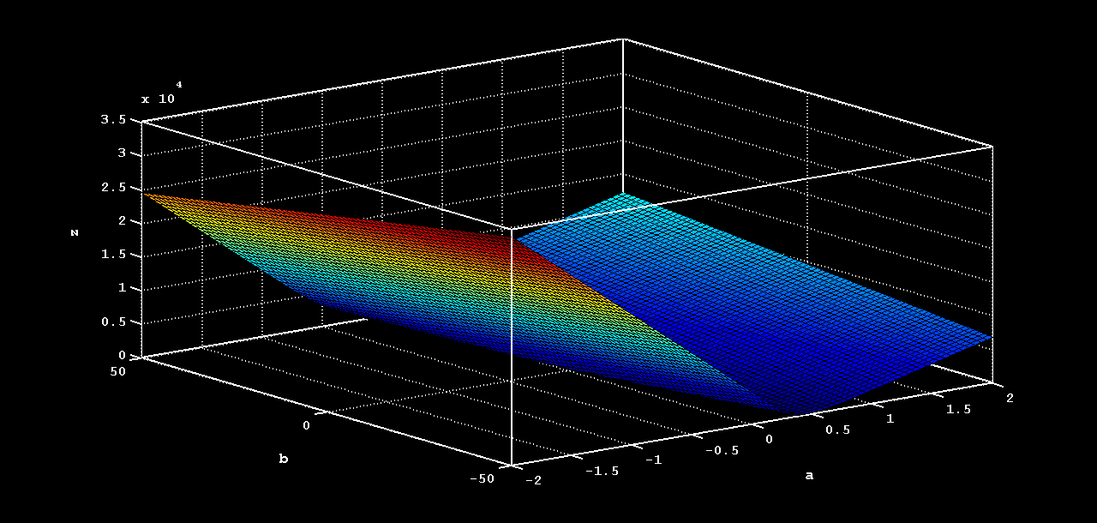
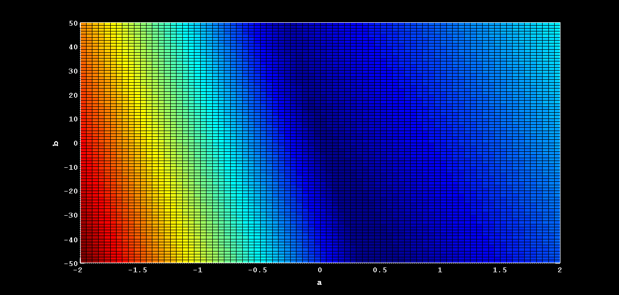


Supp - NUMERICAL MINIMIZATION
$$f\left(a,b\right)=−\sum_{i=0}^{M−1}{a∙u_{i}+b}+\sum_{i=0}^{N−1}{\ln{(1+e^{a∙u_{i}+b})}}$$
$(\tilde{a},\tilde{b})$ s.t. $f\left(\tilde{a},\tilde{b}\right)= f_{min}$

Slide 34



Supp – FOURIER TRANSFORM
FOURIER THEOREM:
Every periodic function $f\left(x\right)$ can be expressed as a sum of pure sinusoidal functions with the appropriate amplitude
$$ℱ\left\{f\right\}\left(t\right)=\hat{f}\left(t\right)=\int_{−∞}^{+∞}{f(x)e^{−ixt}dx}$$
If a discrete periodic function is considered, it can be seen as a sequence of number:
$$\left\{x_{n}\right\}=x_{0},x_{1},…,x_{N−1}$$

Slide 35


Supp – FOURIER TRANSFORM
The DFT (Discrete Fourier Transform) transforms the sequence $\left\{x_{n}\right\}$into another:
$$\left\{X_{k}\right\}=X_{0},X_{1},…,X_{N−1}$$
Where each term of the new sequence is calculated as:
$$X_{k}=\sum_{n}^{N−1}{x_{n}e^{−2πi\frac{kn}{N}}}=\sum_{n}^{N−1}{x_{n}[\cos{\frac{2πkn}{N}−i\sin{\frac{2πkn}{N}}}]}$$

